Slide 1
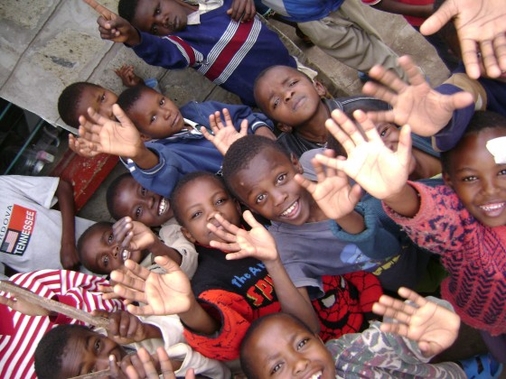
Khulanathi “grow with us”
Khulanathi
“ Grow with us”
Children’s home

Slide 2
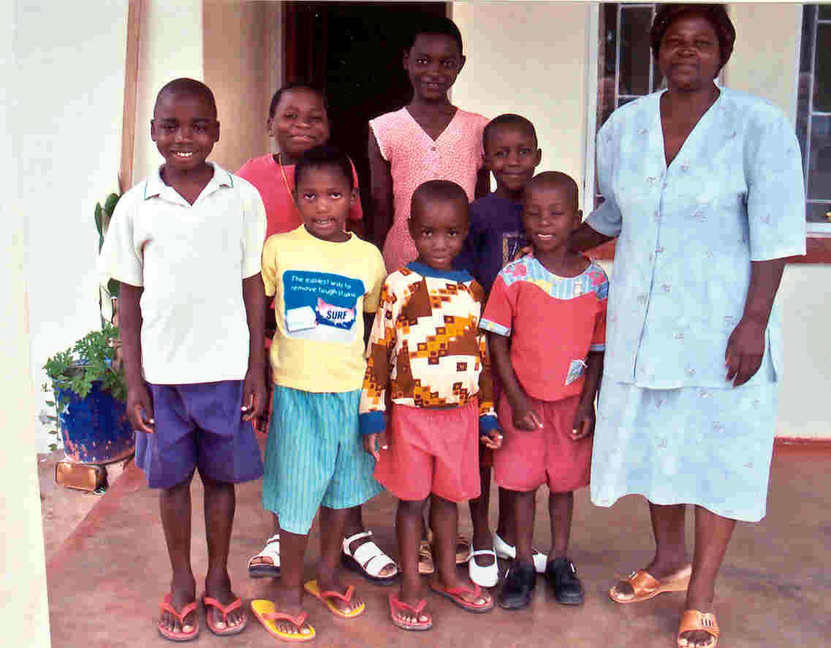
Our Vision:

Slide 3
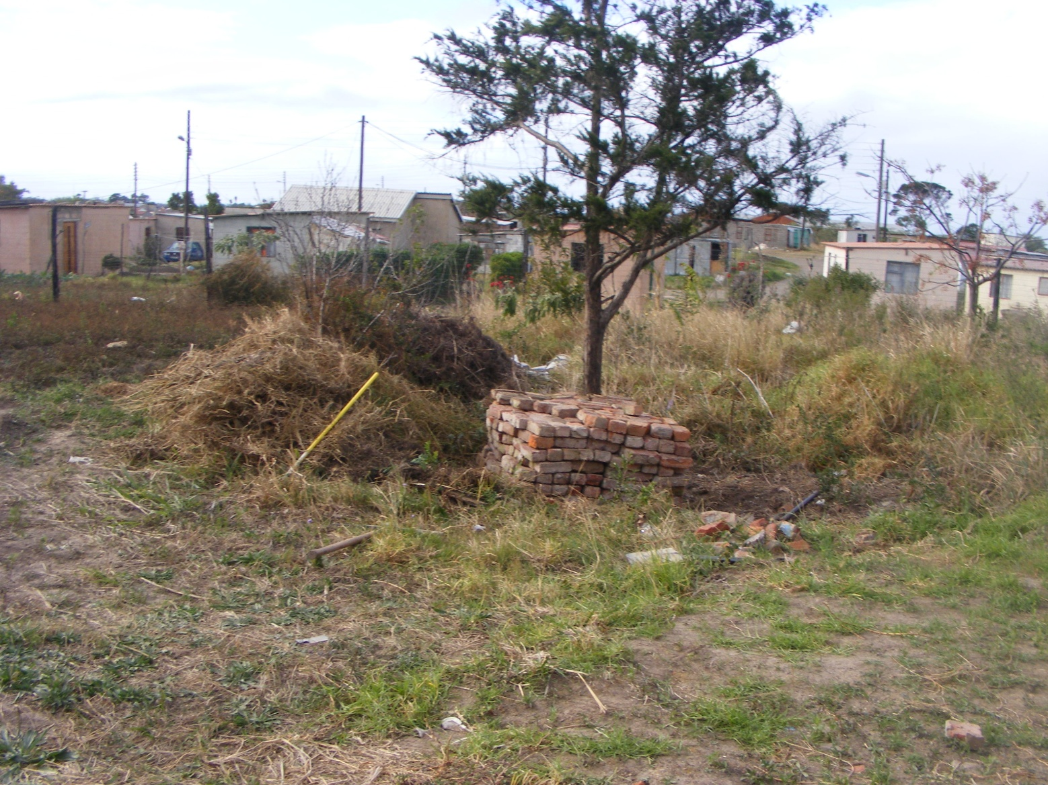
Locating land. Amalinda Forest

Slide 4
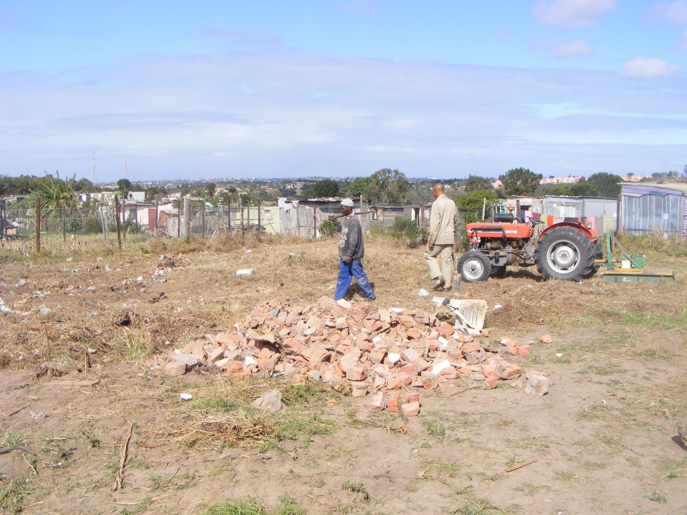
Clearing the site

Slide 5
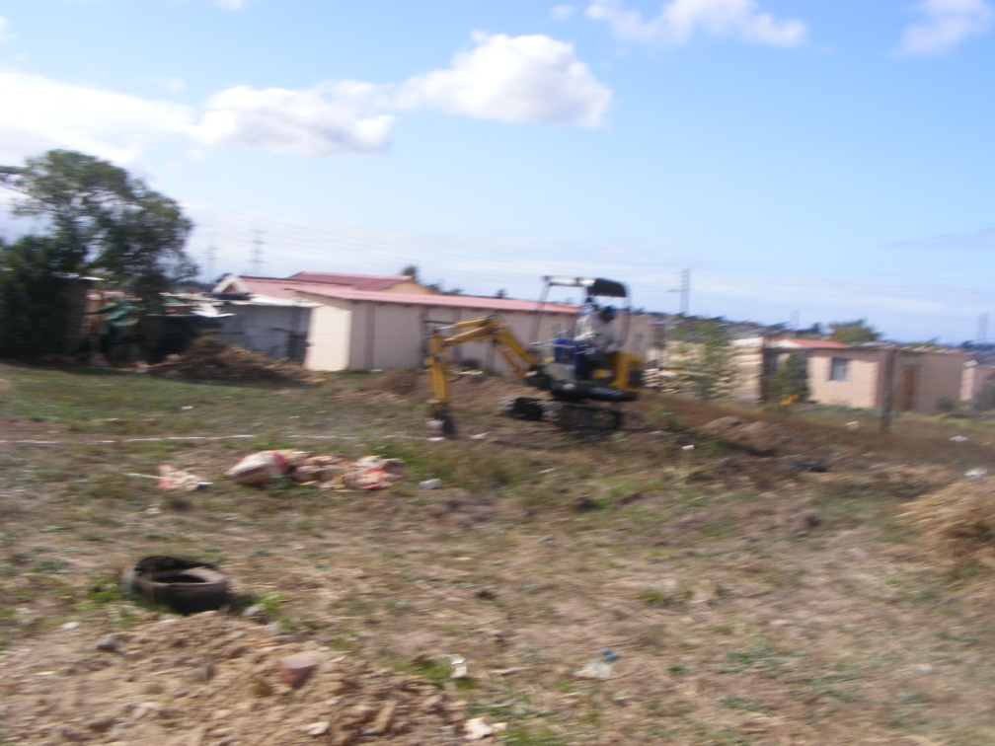
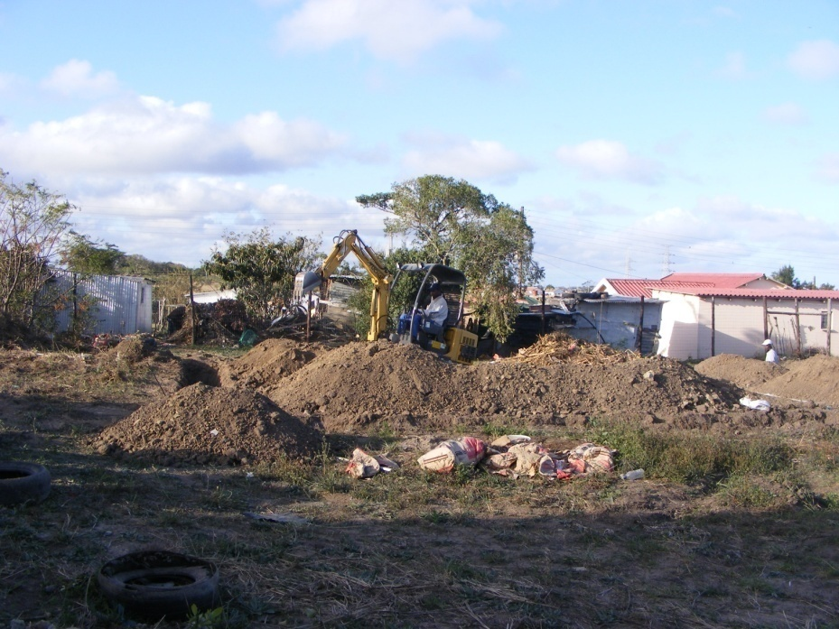
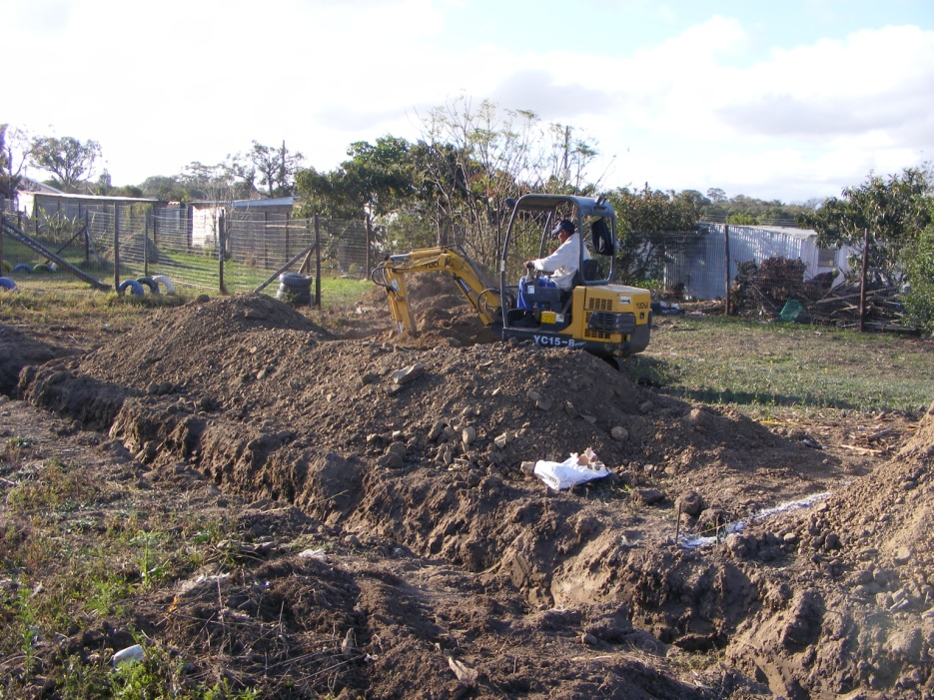
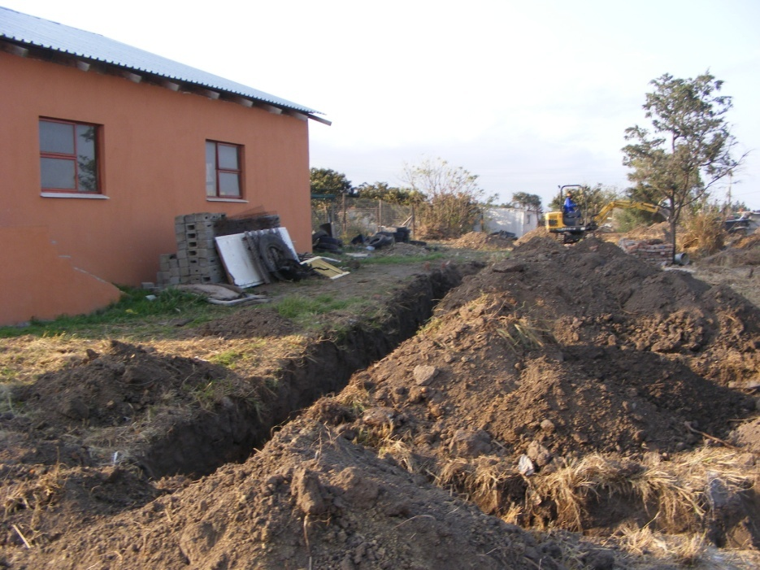
Digging the foundations

Slide 6
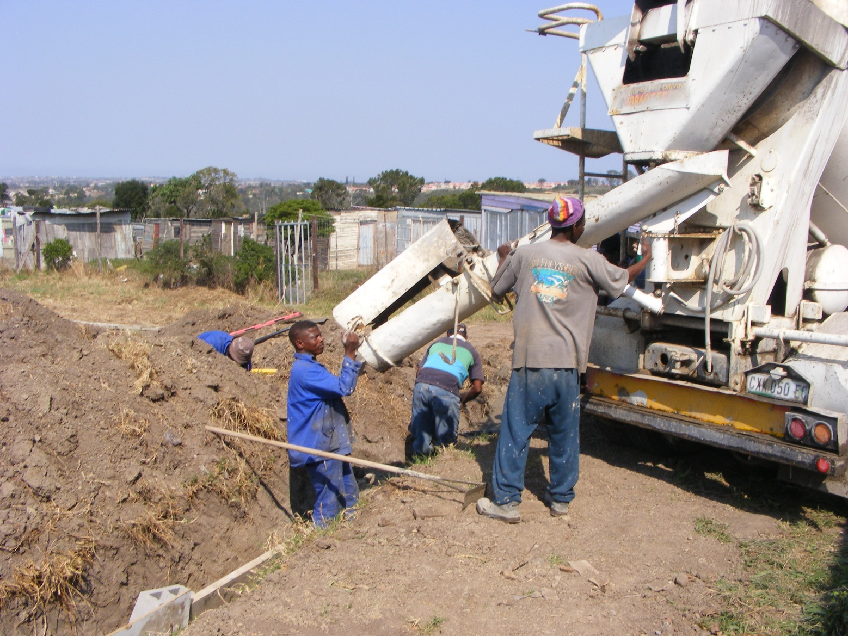
Pouring foundation

Slide 7
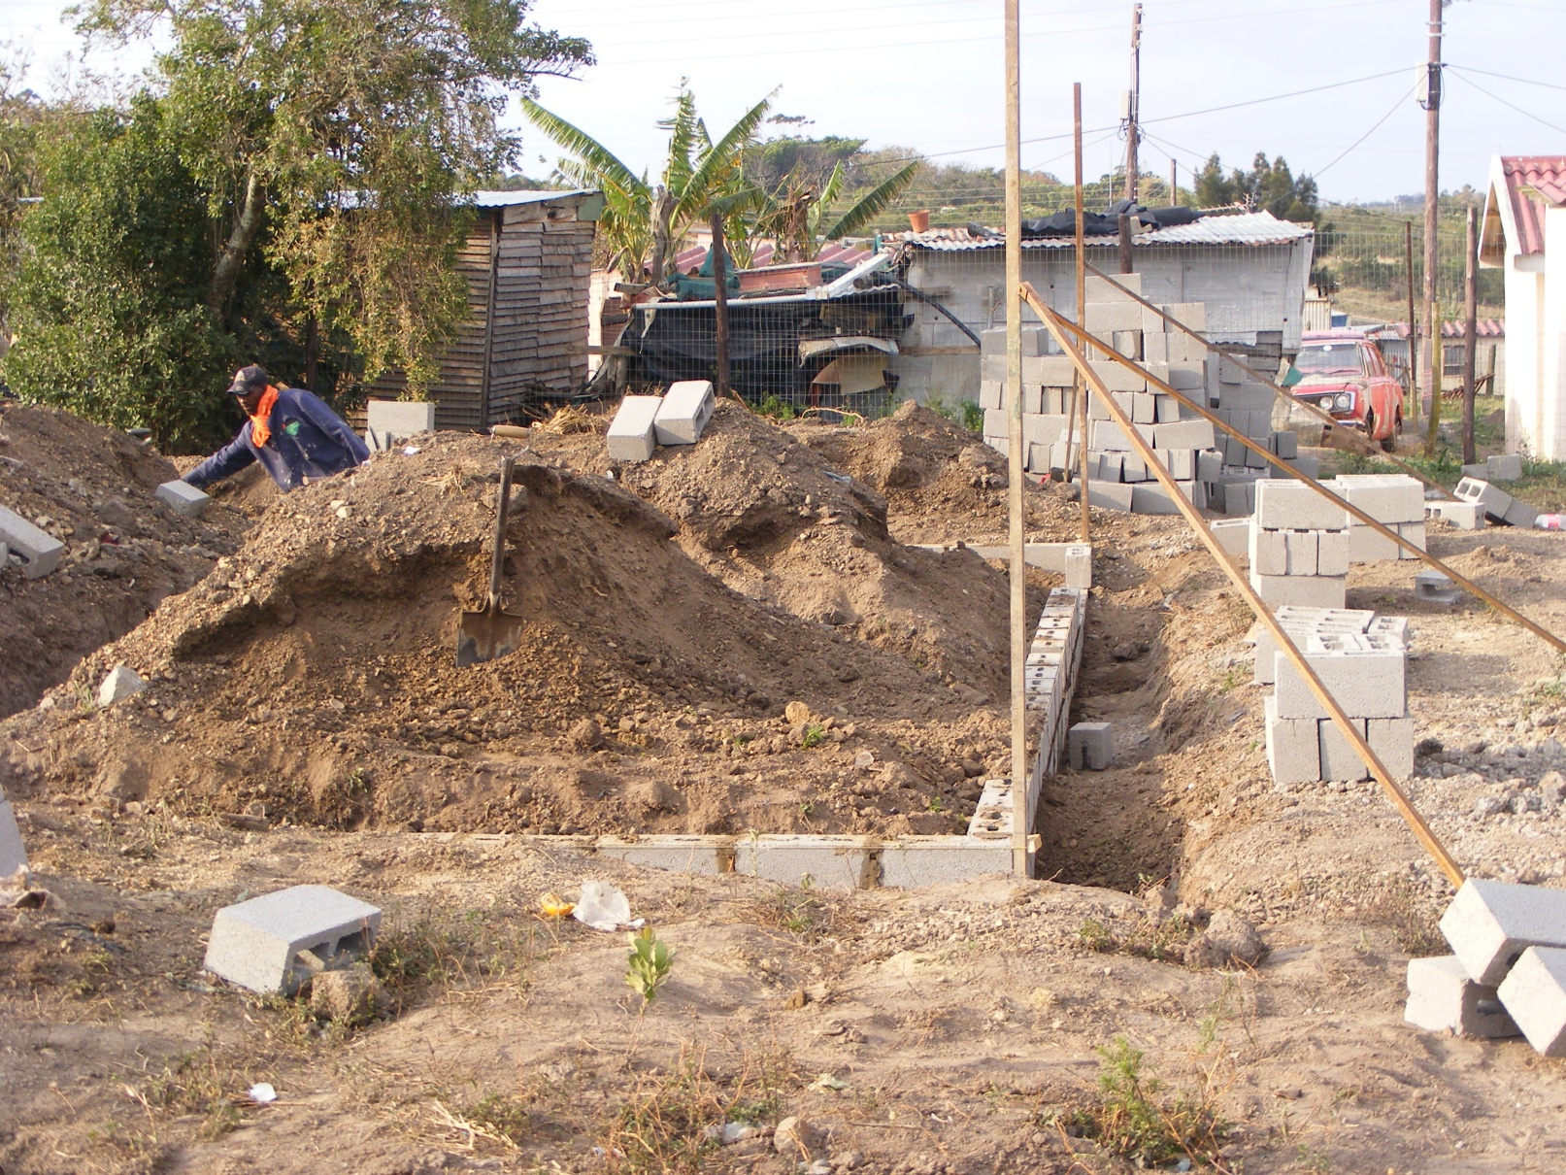
Foundation walls

Slide 8
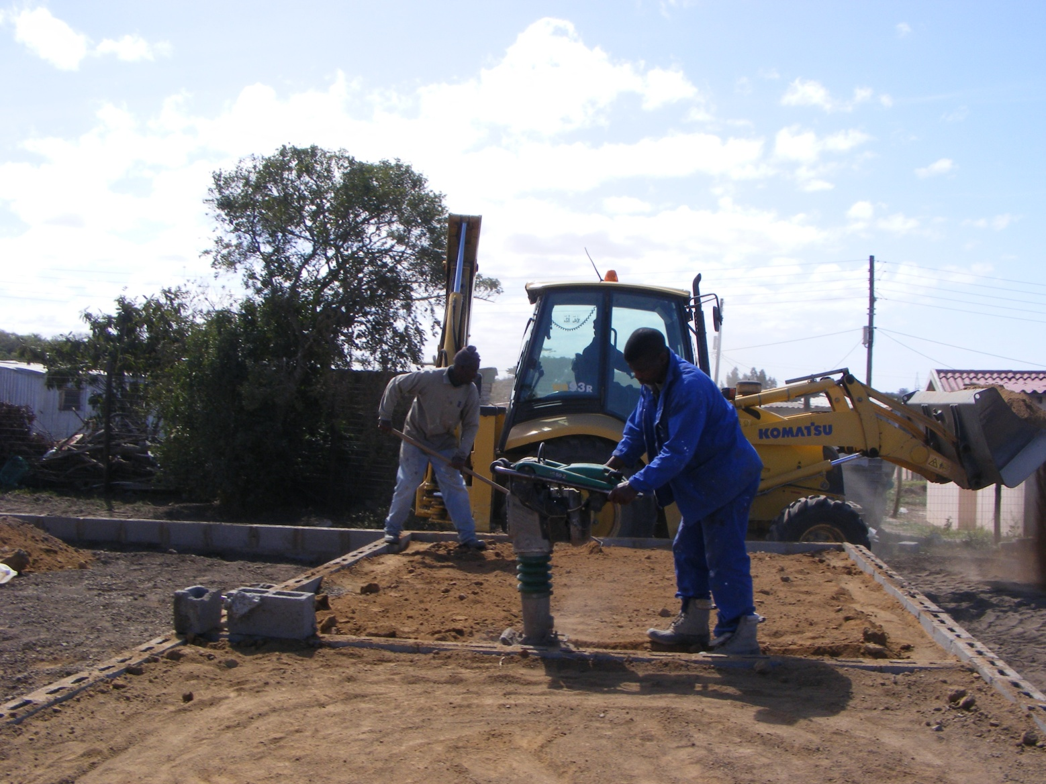
Compacting

Slide 9
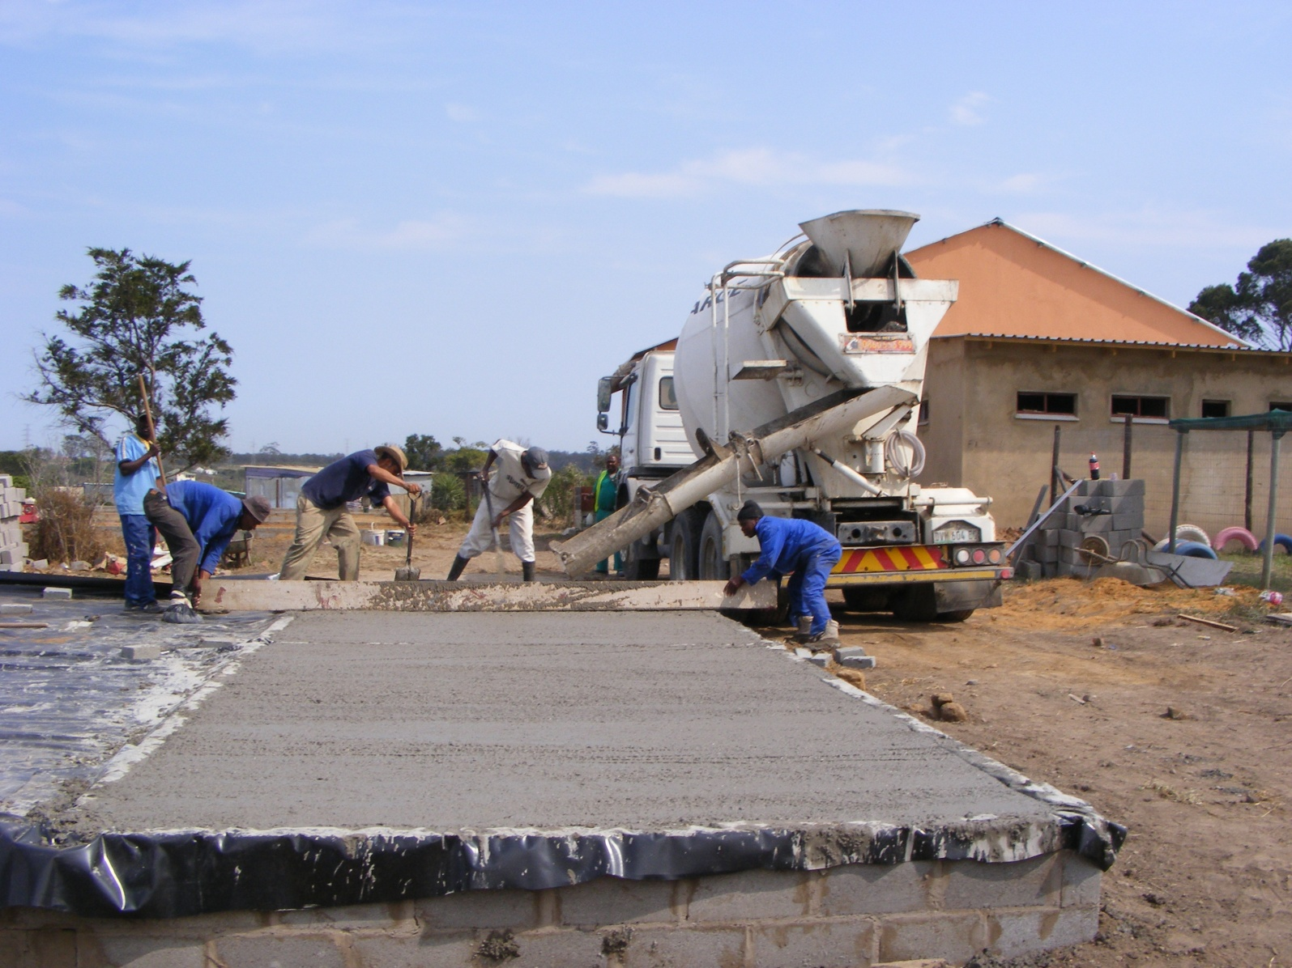
Pouring the floor

Slide 10
Putting up the outer and inner walls

Slide 11
Team 2 putting the trusses up on hose 2

Slide 12
Team 2 completing the roof on house 1

Slide 13
Team 3 fitting the windows

Slide 14
Plastering the homes

Slide 15
Fitting the electrics

Slide 16
Outer coat complete

Slide 17
House 1

Slide 18
House 2

Slide 19
Outside of house 1

Slide 20
Fitting the kitchen cupboards

