Slide 1
South Africa 2013

Slide 2
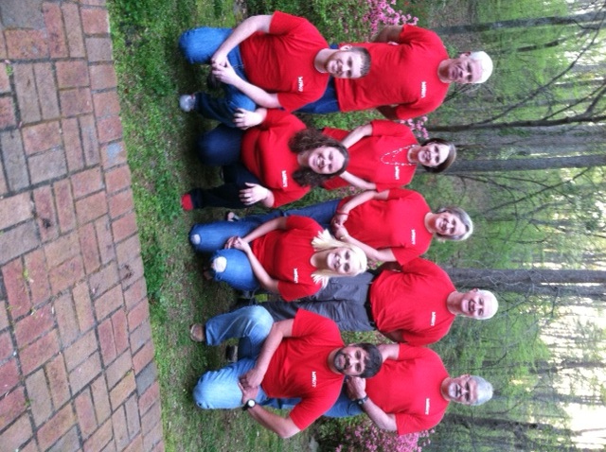
God chose the team

Slide 3
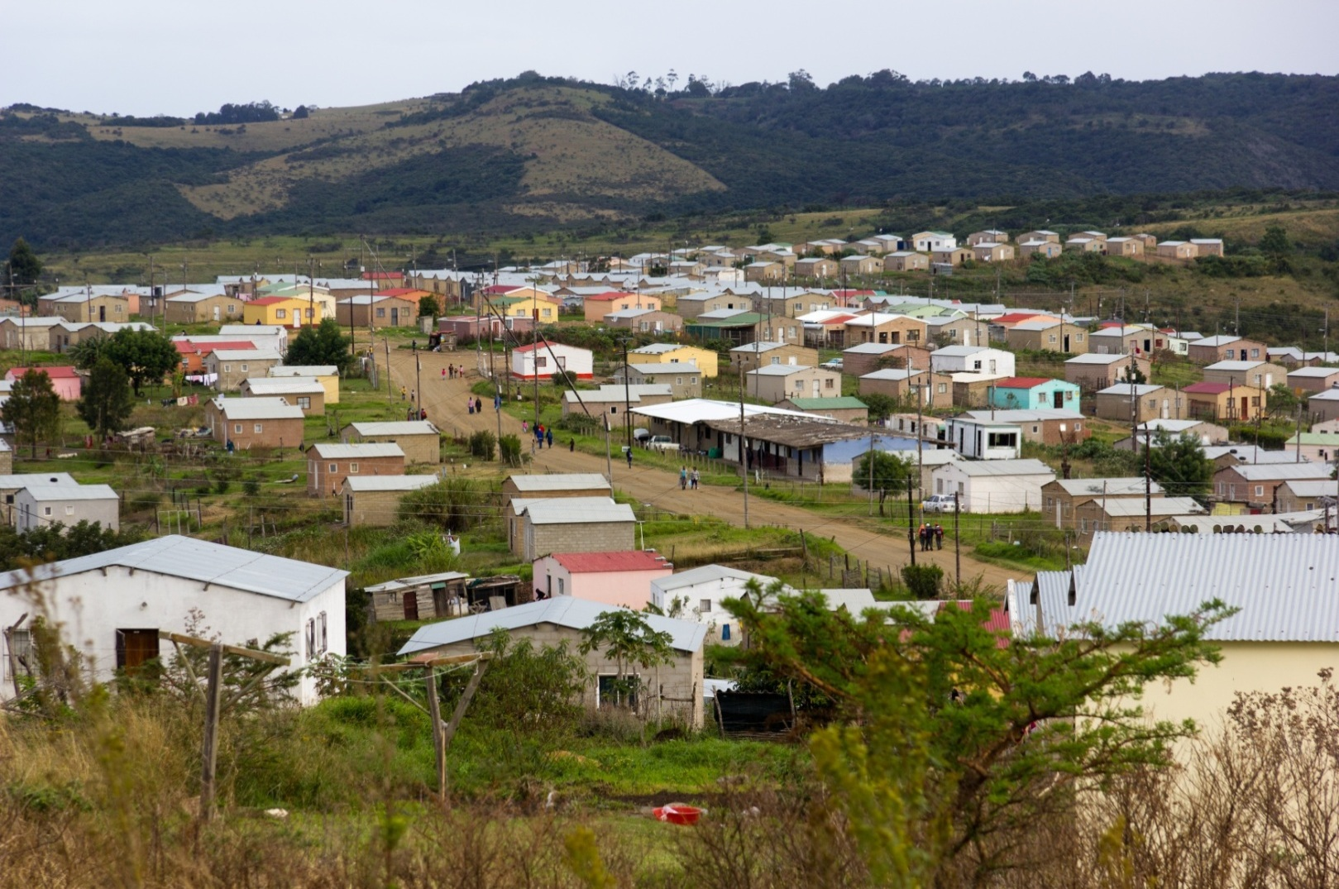
God chose the mission – a new circle to be started in a previously closed Xhosa township – Biko Village

Slide 4
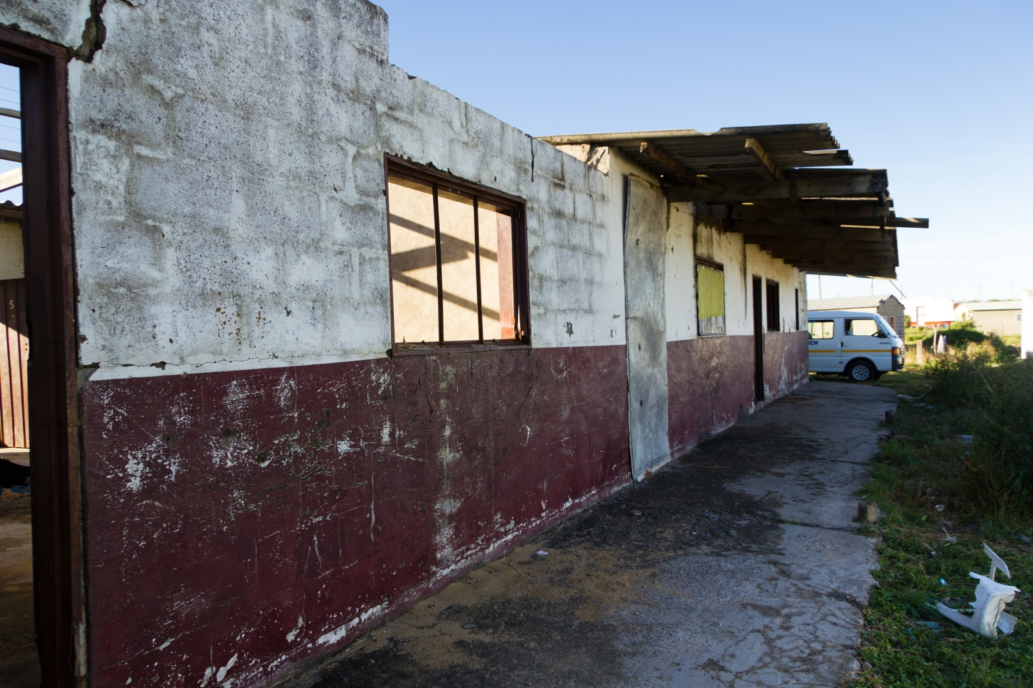
God provided us with an old building to renovate to become a church

Slide 5
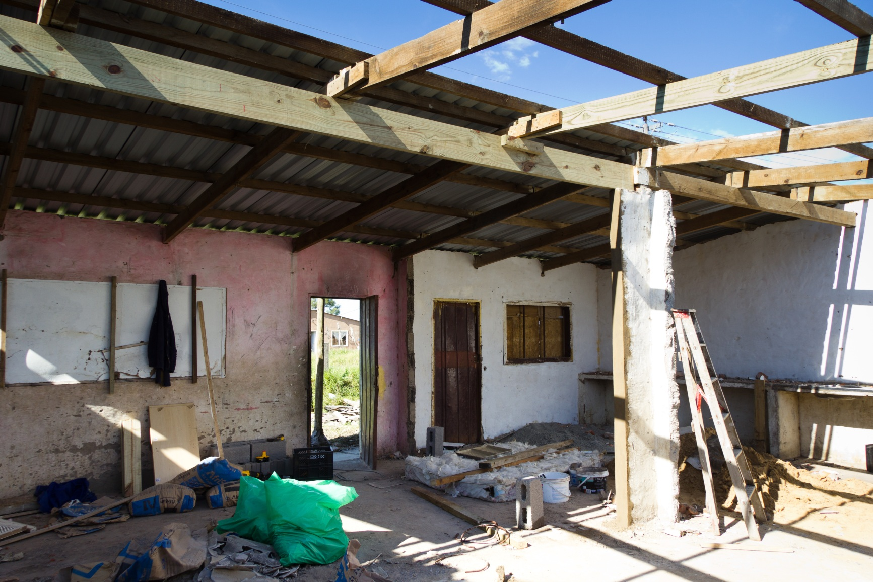
Much work would be needed inside and out to make a church

Slide 6
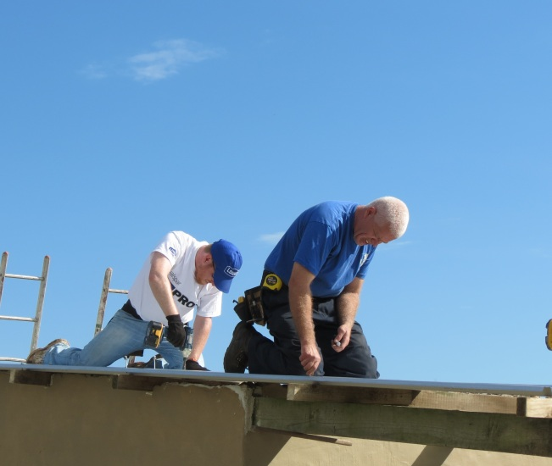
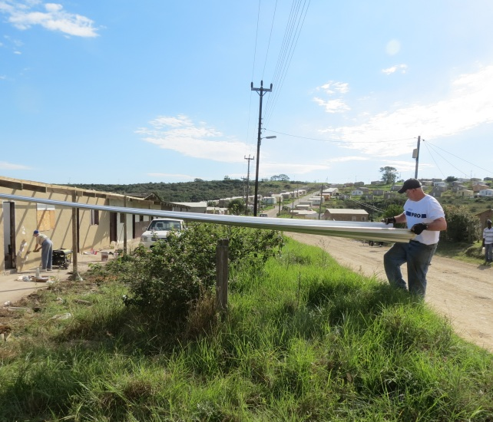
A new Roof was needed

Slide 7
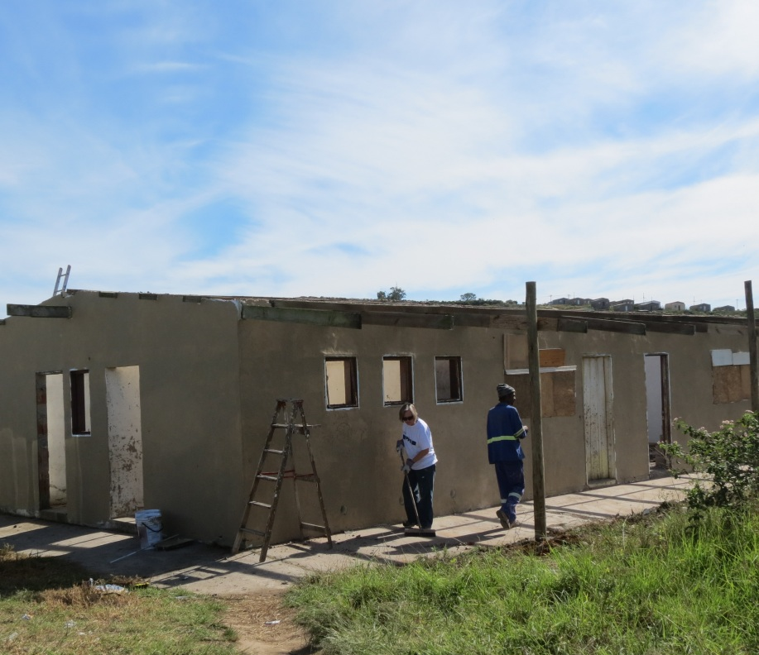
The walls had to be rebuilt and then painted inside and out

Slide 8
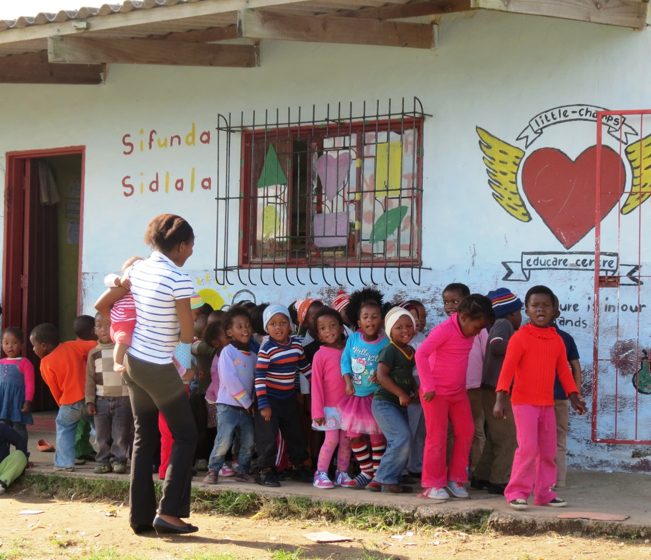
A daycare was operating on one end of the old building

Slide 9
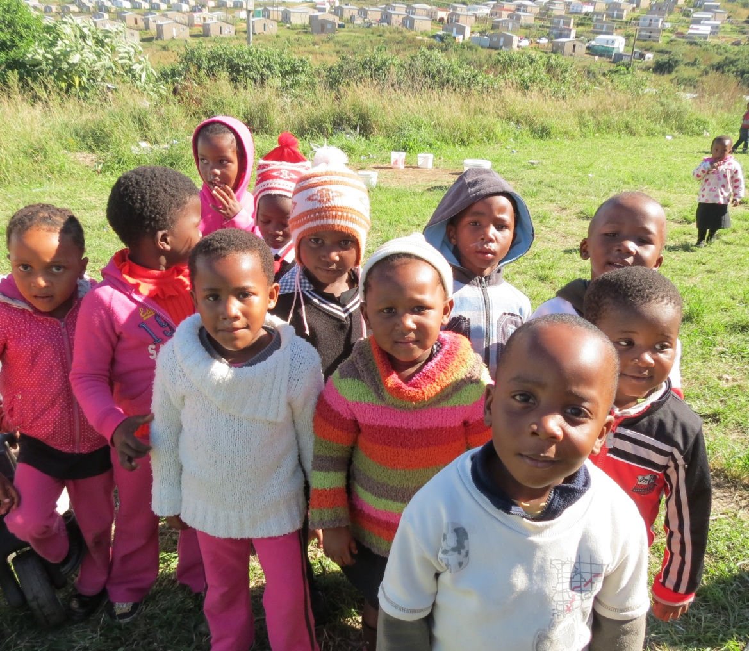
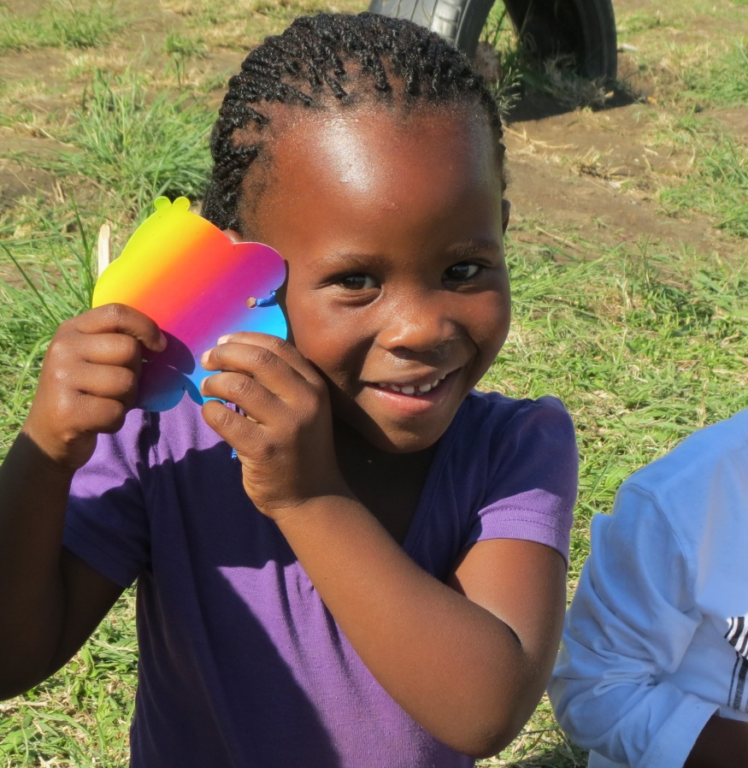
So we had VBS with the Daycare children

Slide 10
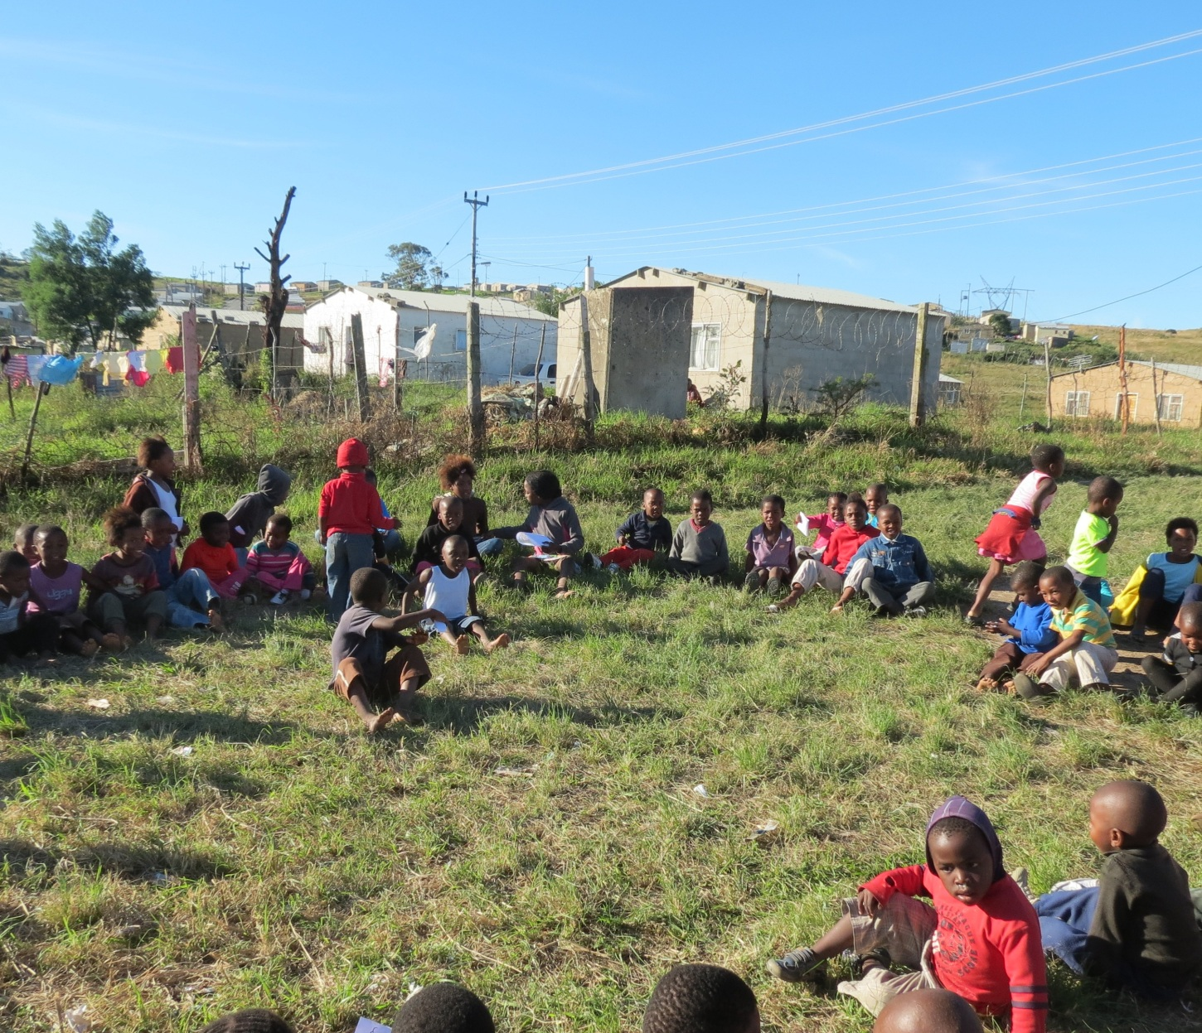
VBS outside with the Daycare children

Slide 11
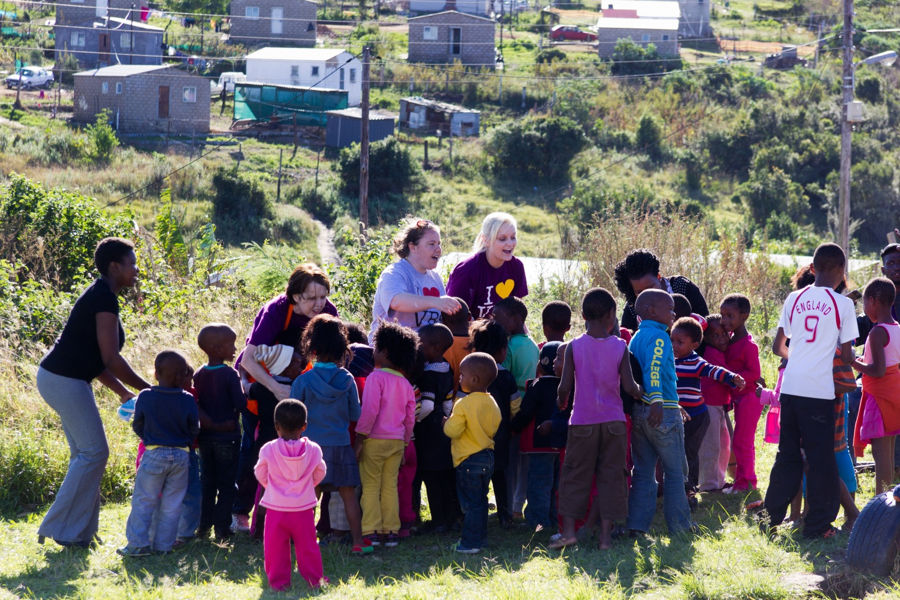
We had VBS with the Community children as well

Slide 12
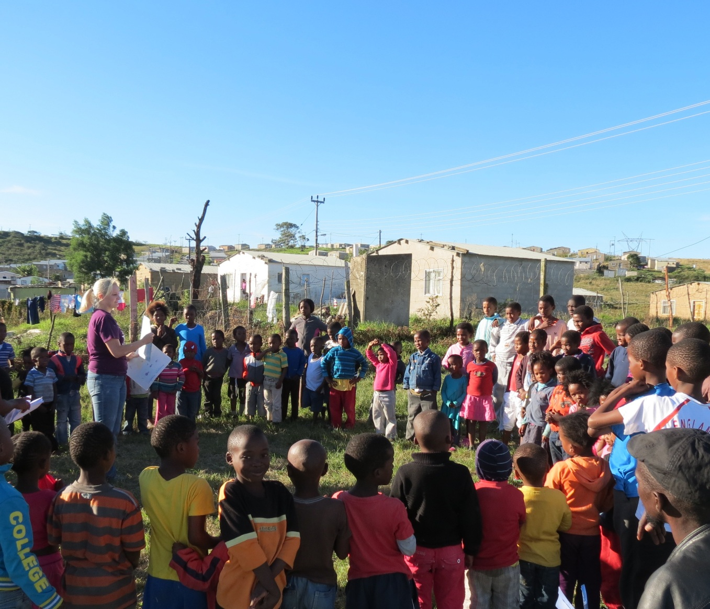
Every day we had more children come for VBS

Slide 13
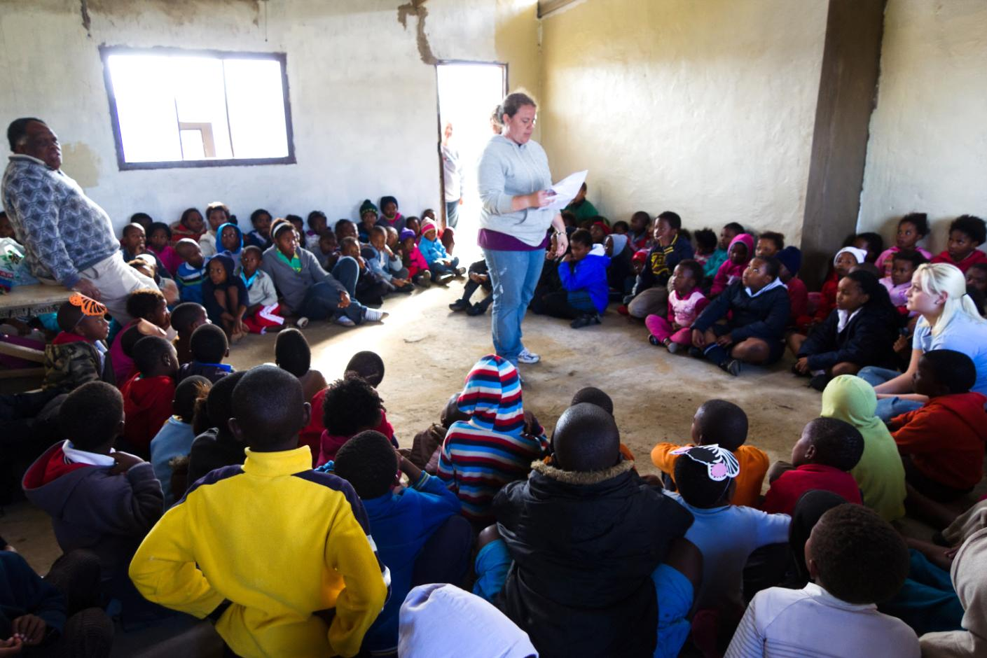
The final day of VBS it rained so we moved inside the newly renovated building and the plan of salvation was presented. Many hands were raised accepting Him into their hearts and lives

Slide 14
The Community came together in the new building and wanted to share their culture with us

Slide 15
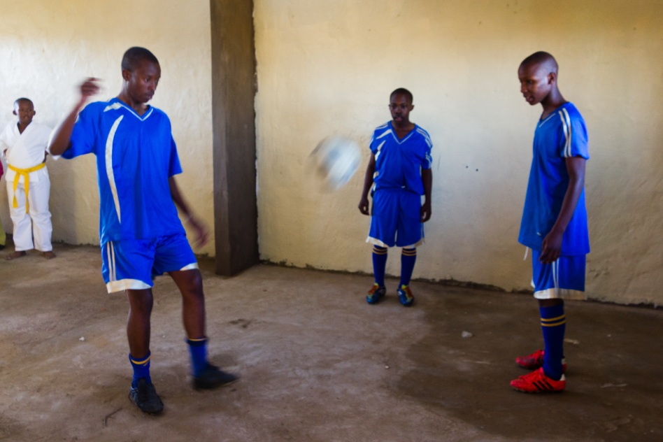
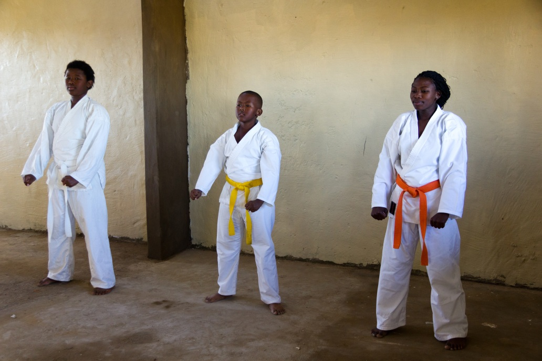
They shared some of their favorite activities with us

Slide 16
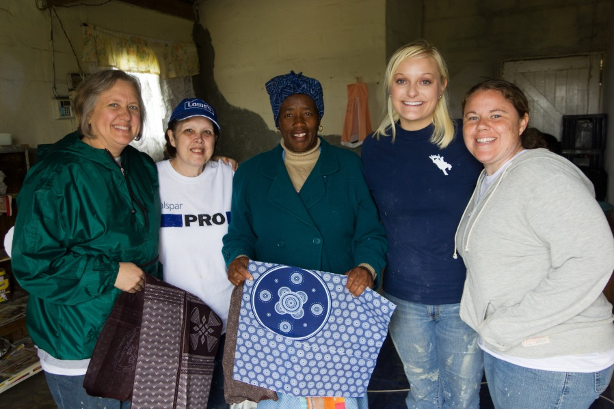
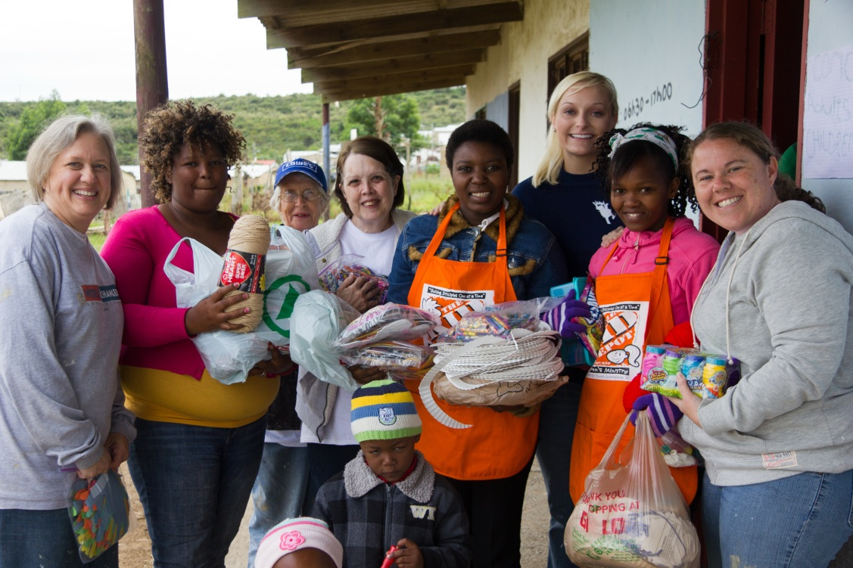
It was hard leaving our new friends at Biko Village

Slide 17
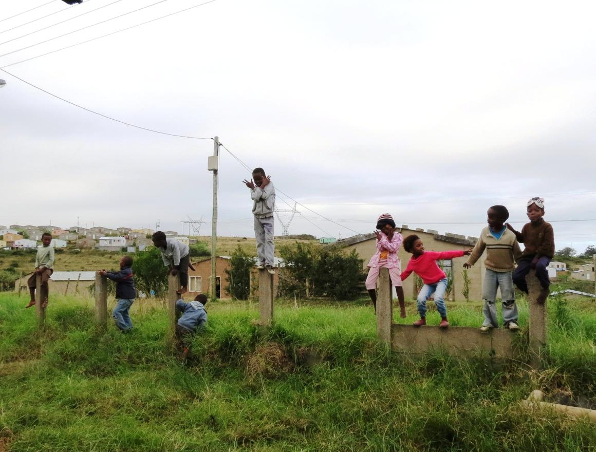
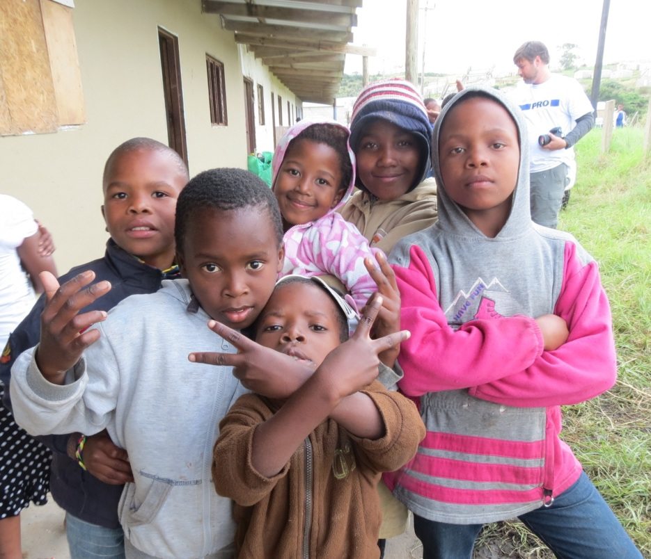
The children came to tell us goodbye

Slide 18
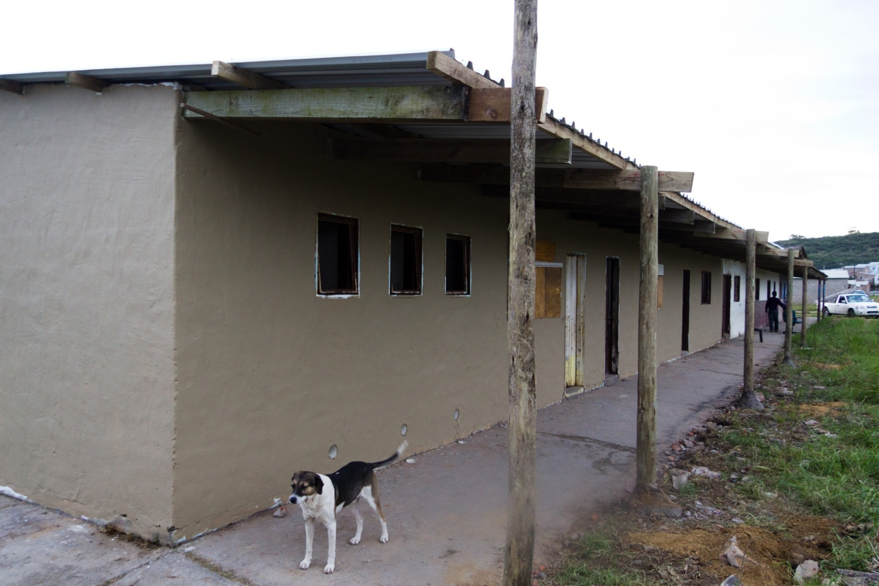
We finished the work given to us, but it is far from being done at Biko Village

Slide 19
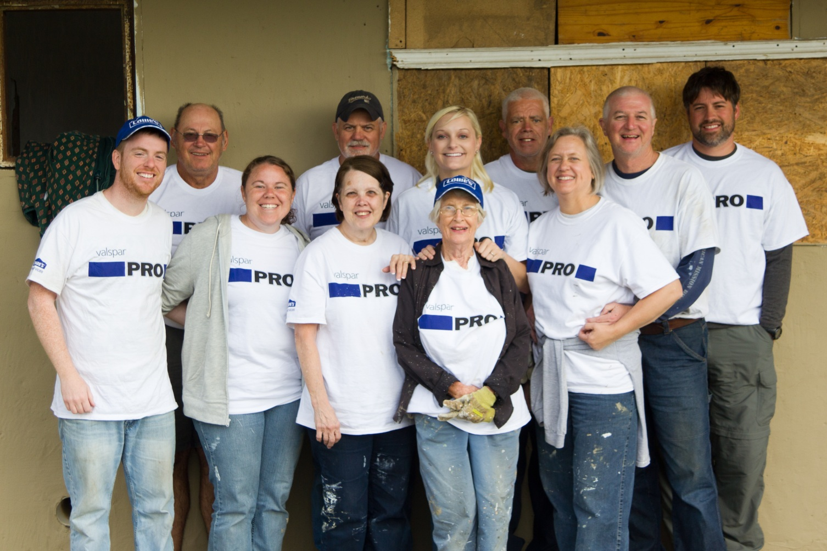
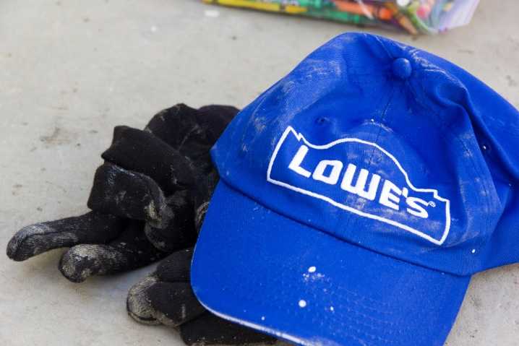
Team 2013 – thanks Lowes!

Slide 20
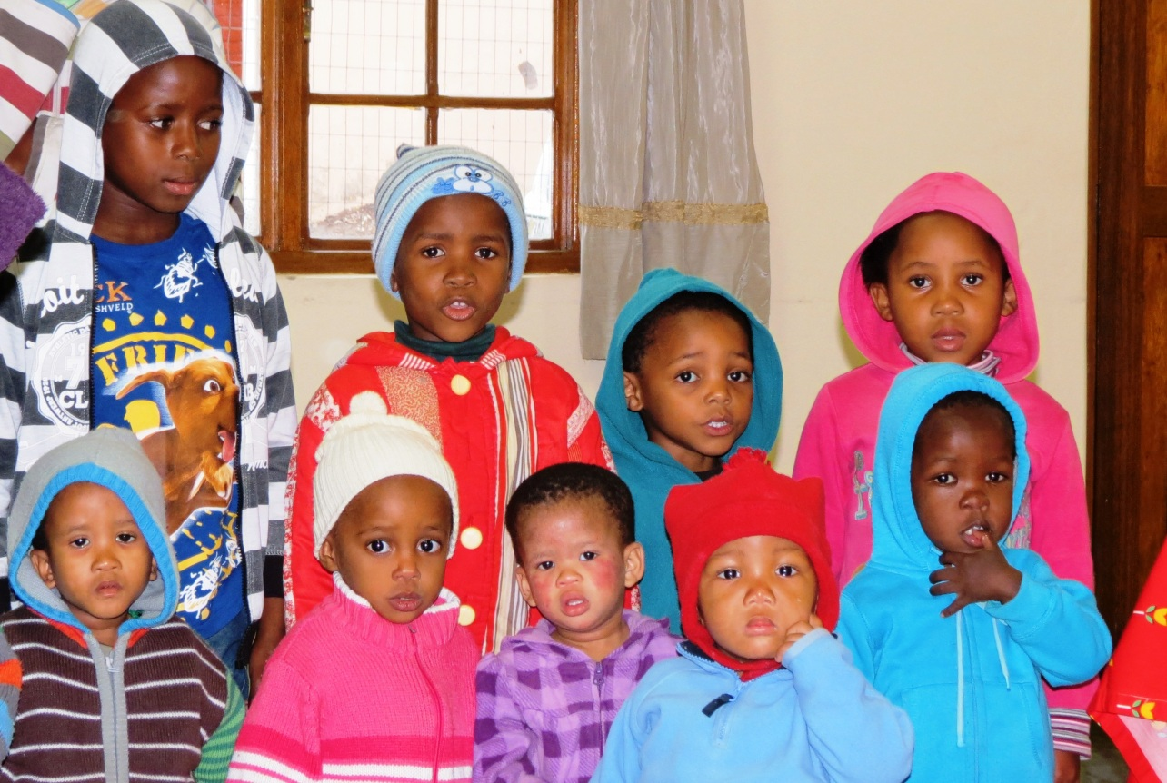
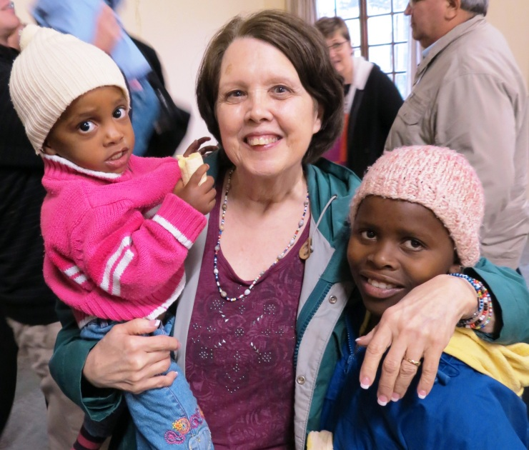
We also were able to spend time with the children of Amalinda Forest – our first circle we had completed

Slide 21
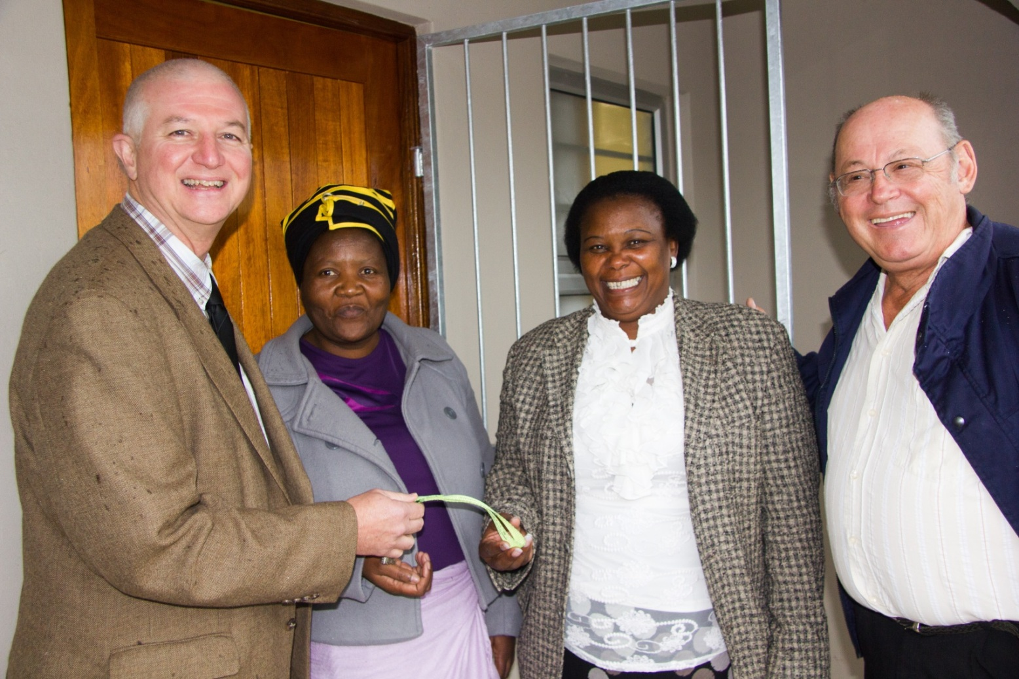
We witnessed the dedication of the home we helped to build last year in Scenery Park

Slide 22
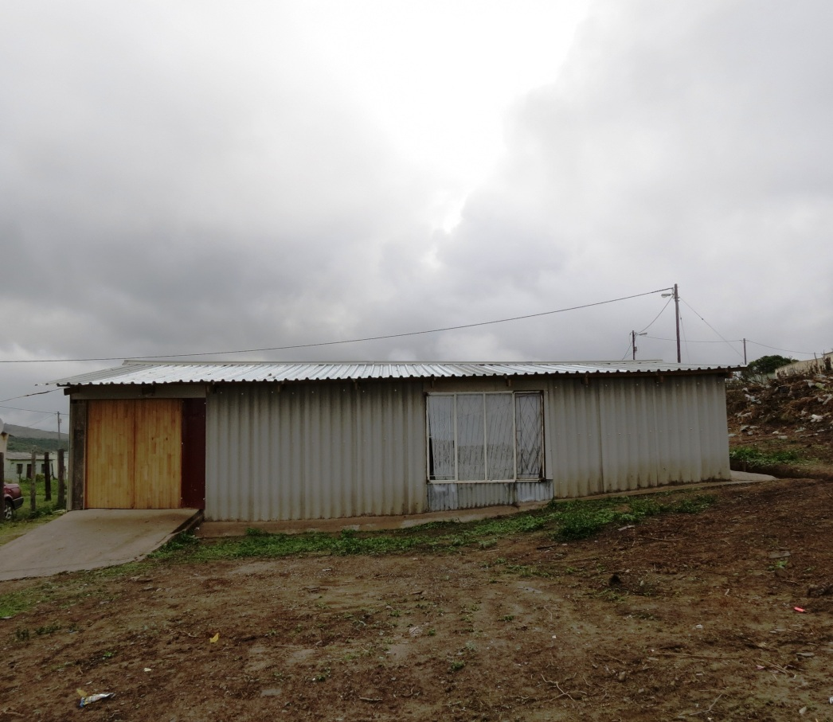
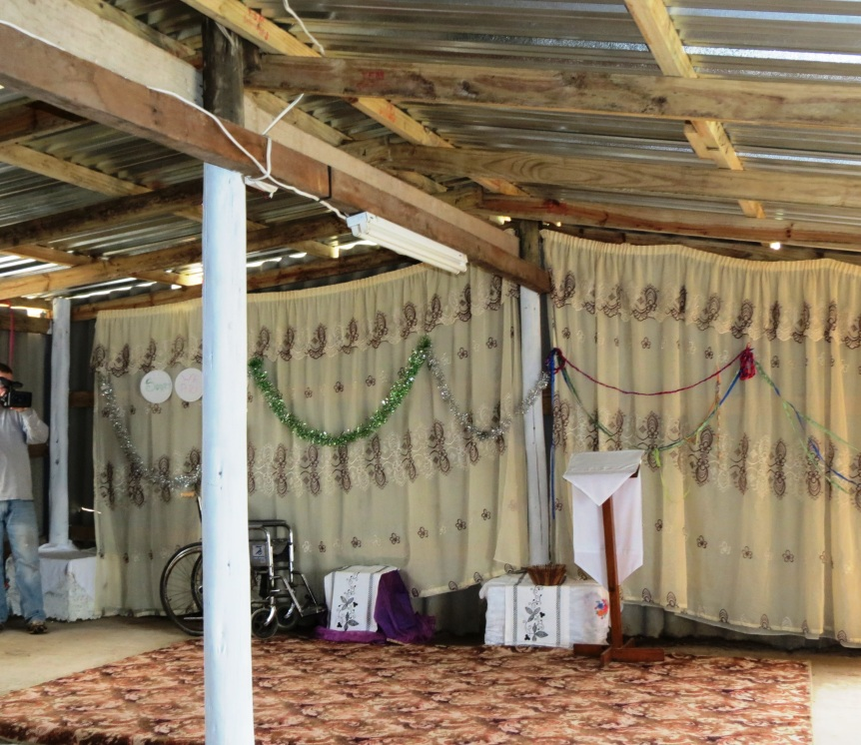
We visited Khayelitsha – a temporary church has been established and another circle started – a permanent church is needed, along with a childcare center

Slide 23
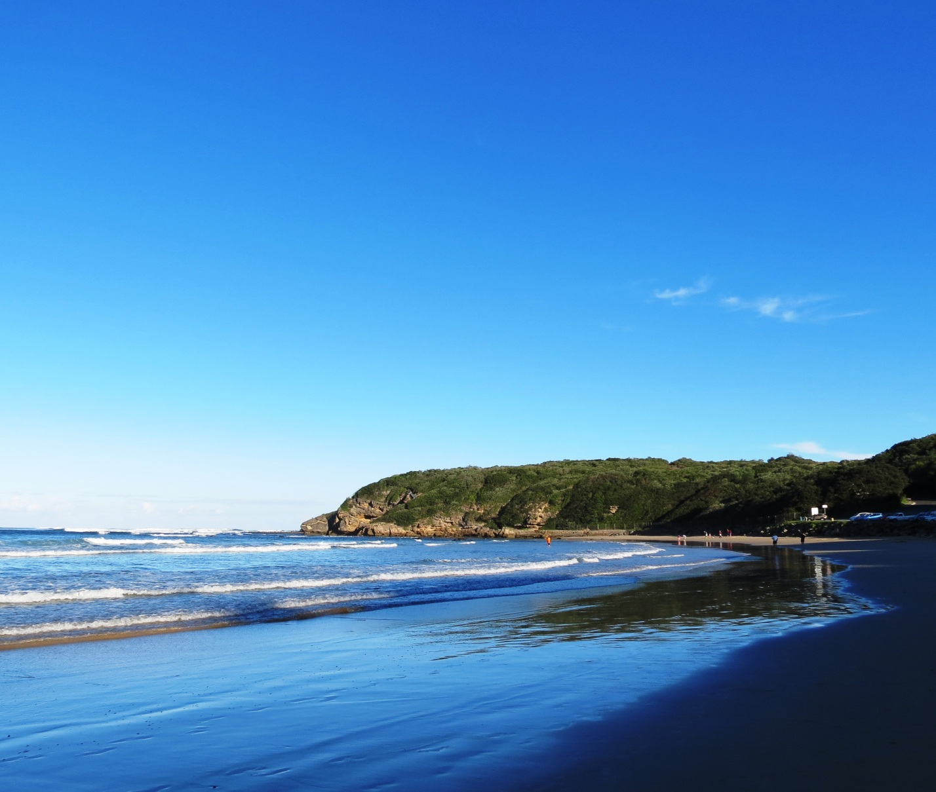
We witnessed the beauty of God’s creation

Slide 24
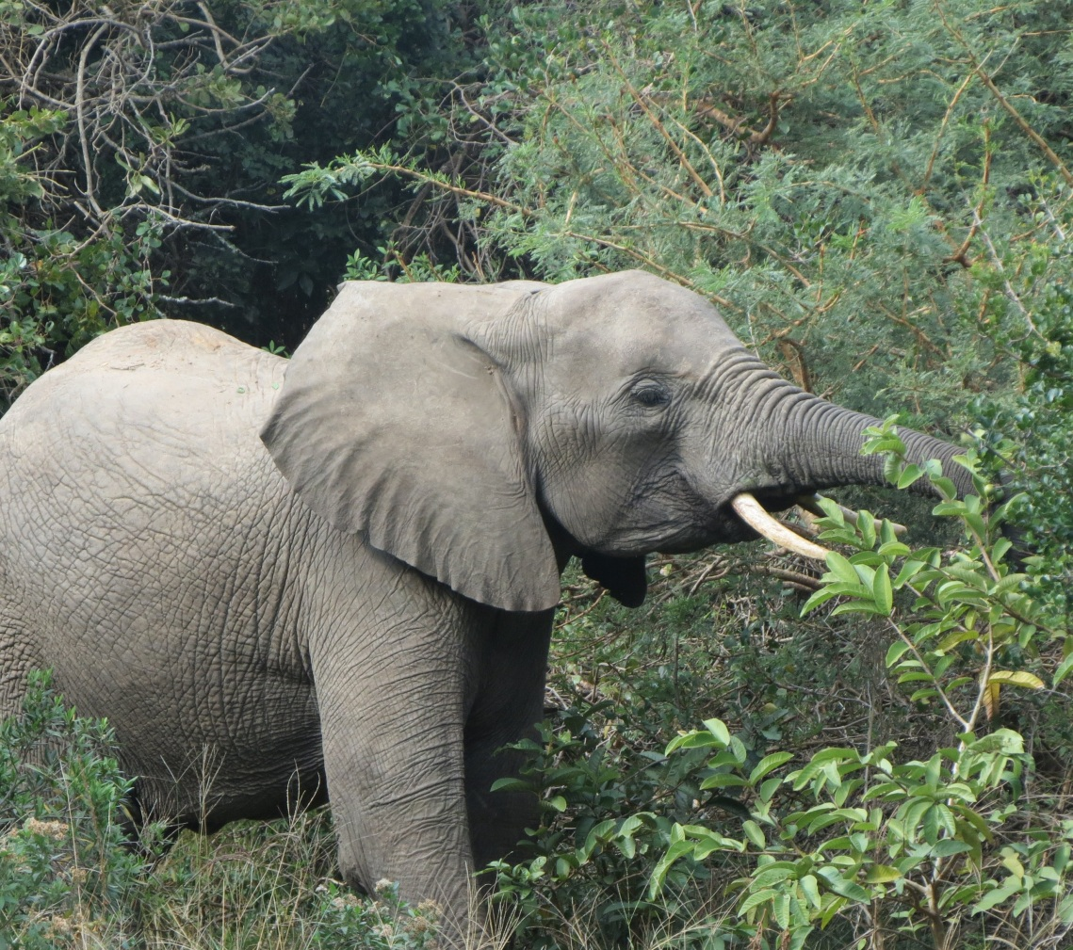
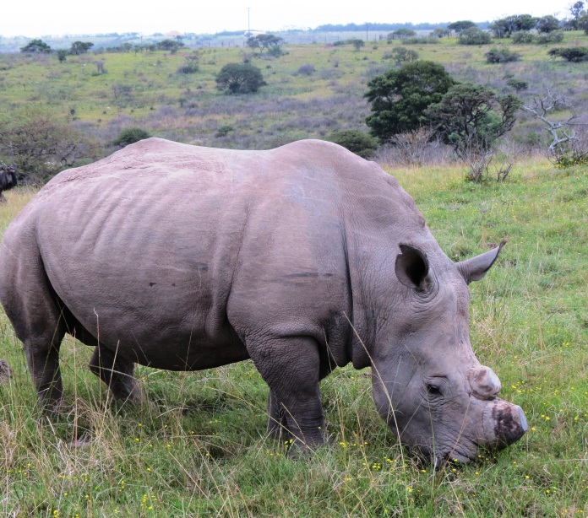
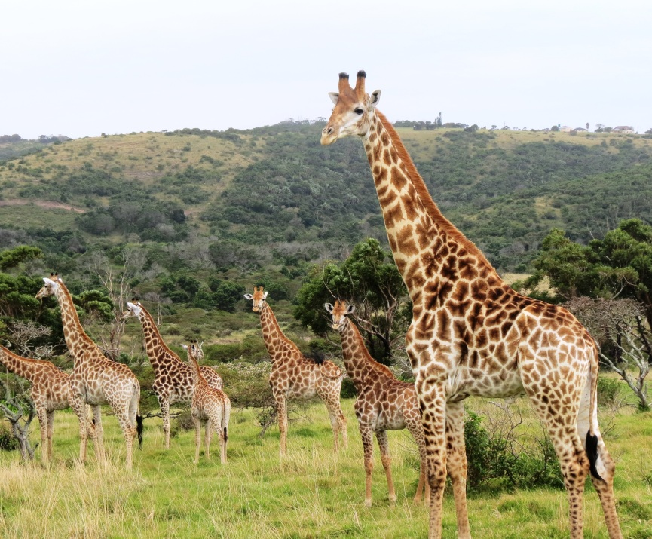
We saw His creatures great

Slide 25
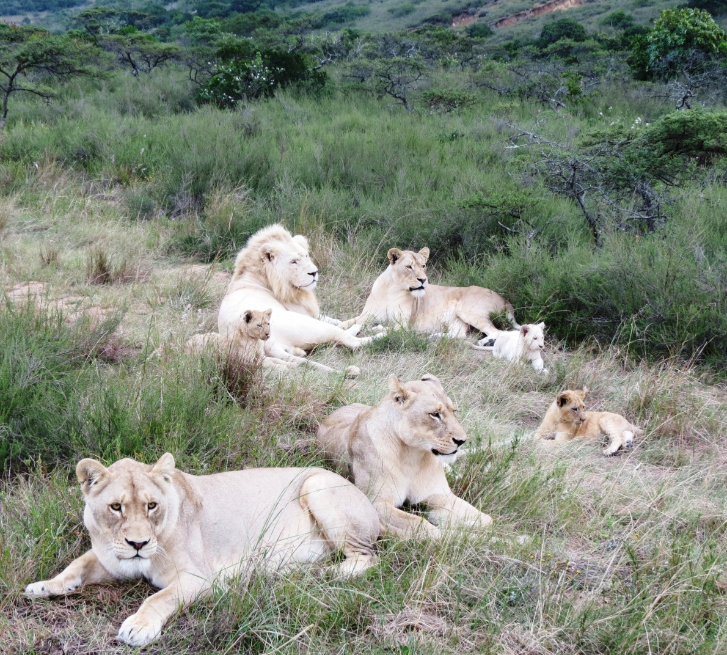
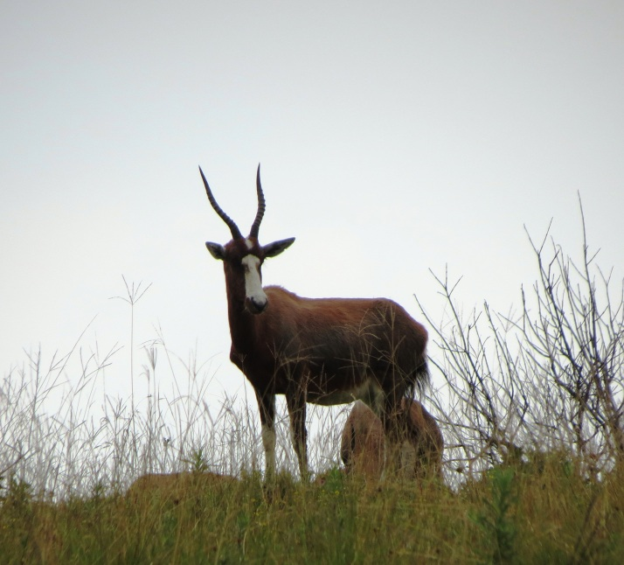
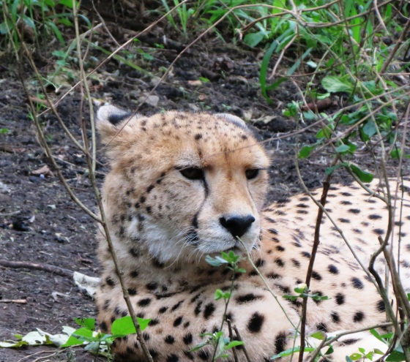
We saw His creatures small

Slide 26
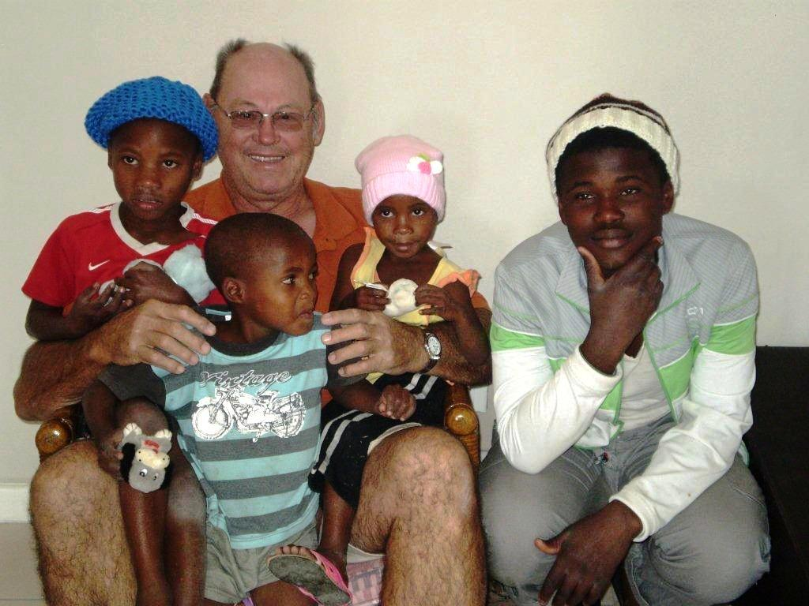
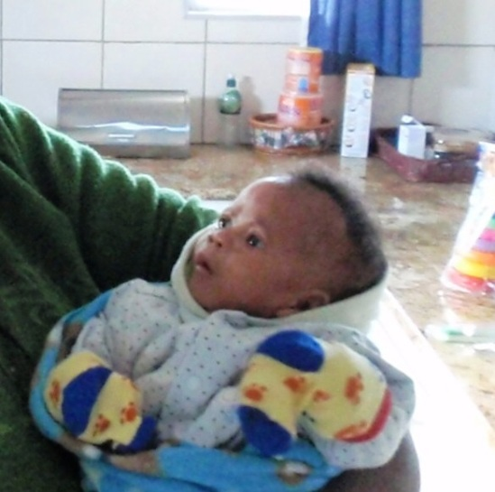
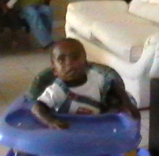
The children arrived at Scenery Park soon after the team left

Slide 27
Scenery Park Children: Siyanele (10 weeks), Banele (19 months), Lviwe (4), Nyocuma (5), and Nyobongo (7) – all siblings, and Sikho (15)

Slide 28
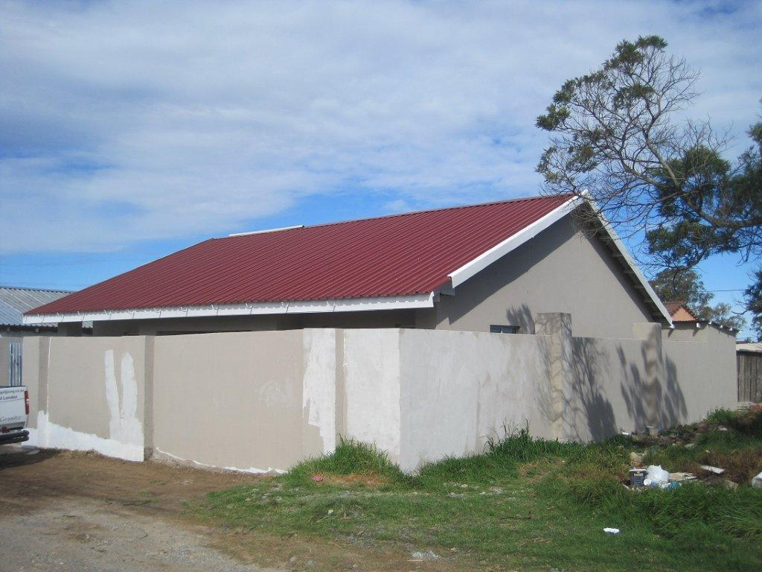
Another home is needed at Scenery Park Pray for land to become available adjacent to the home along with an area for a playground for the children not only of the home, but of the community.

Slide 29
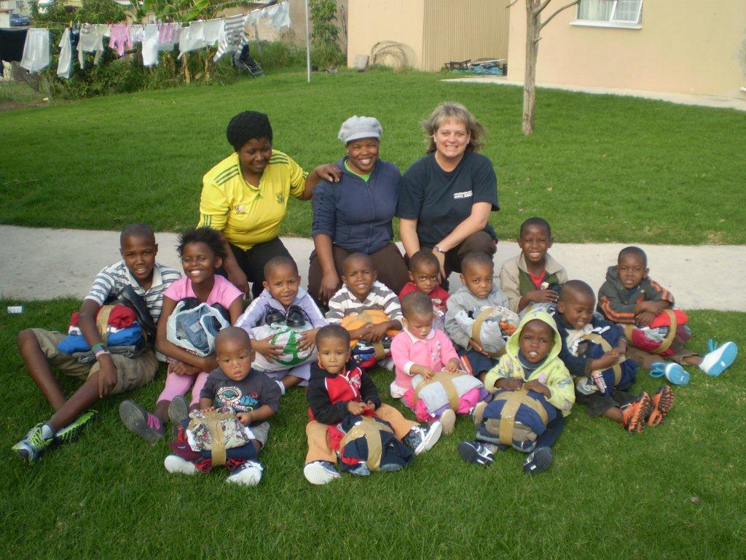
The children in the homes we helped to build at Amalinda Forest

Slide 30
Amalinda Forest Children: Ronien, Imanthi, Rowen, Liza-lisa, Hlumelo, Lutho, Endinako, Masibule, Ayaka, Ajedene, Simamkele, Songezo, and Mvano

Slide 31
TOP: Simamkele (9), Ayaka (6), Lutho (4), Endinako (4) Front: Rowen (3), Liza-Lisa (3), Ronien (2), Imanthi (2), Hlumelo (4)

Slide 32
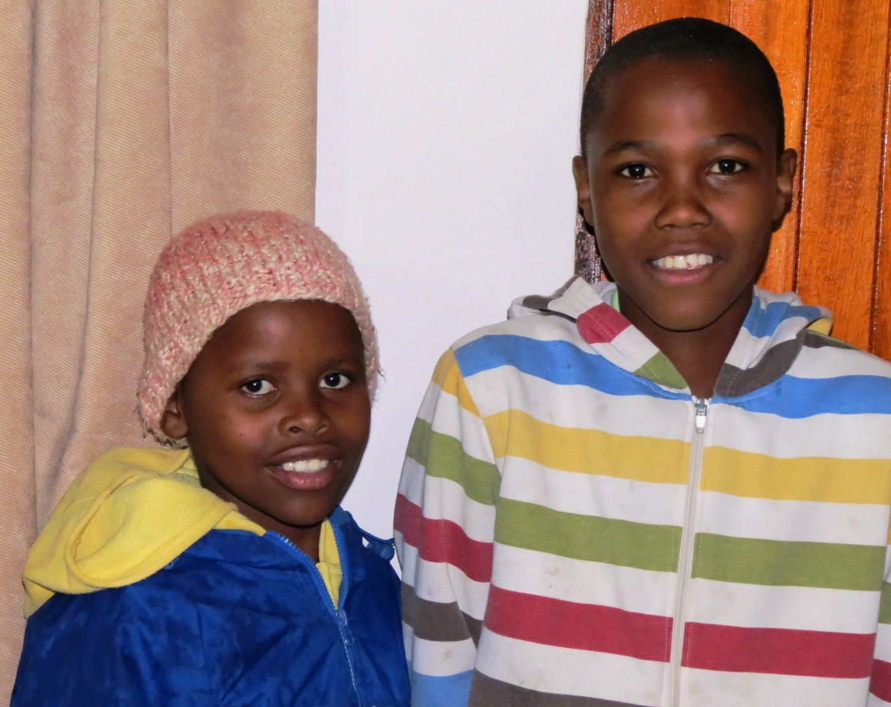
Songeza (11) and Mvano (12)

Slide 33
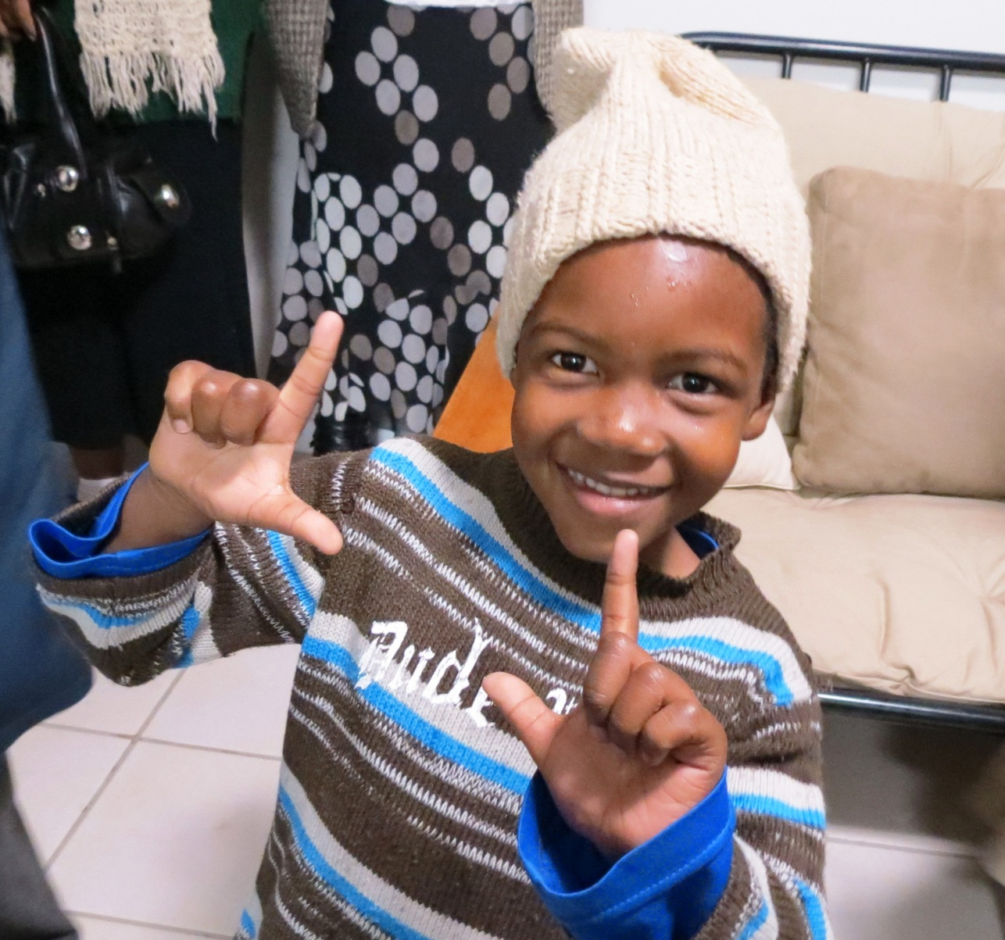
Ajedene (6)

Slide 34
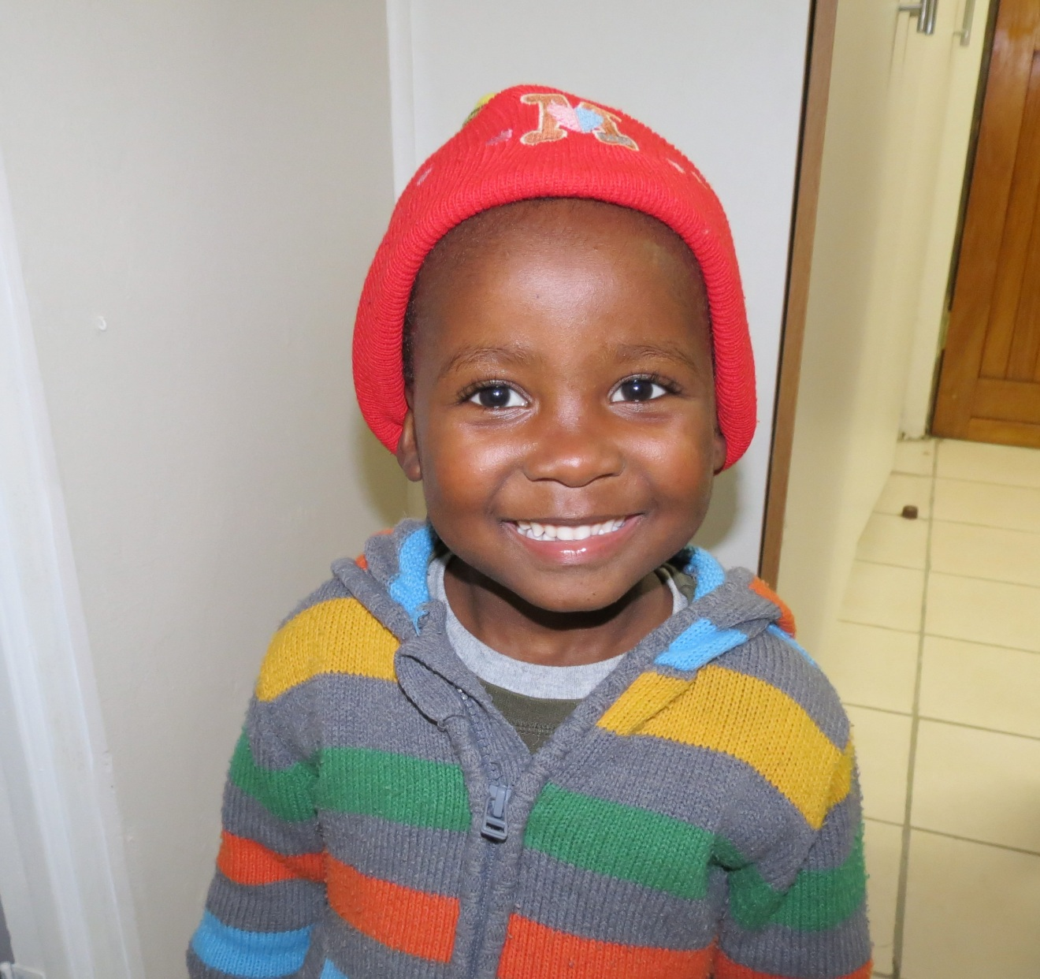
Masibule (Penguin) 4

Slide 35
We will return in 2014 to continue the work How about you? Will you go with us? If you cannot go, will you pray, encourage, and support those who can go? We cherish your partnership!

