Slide 1
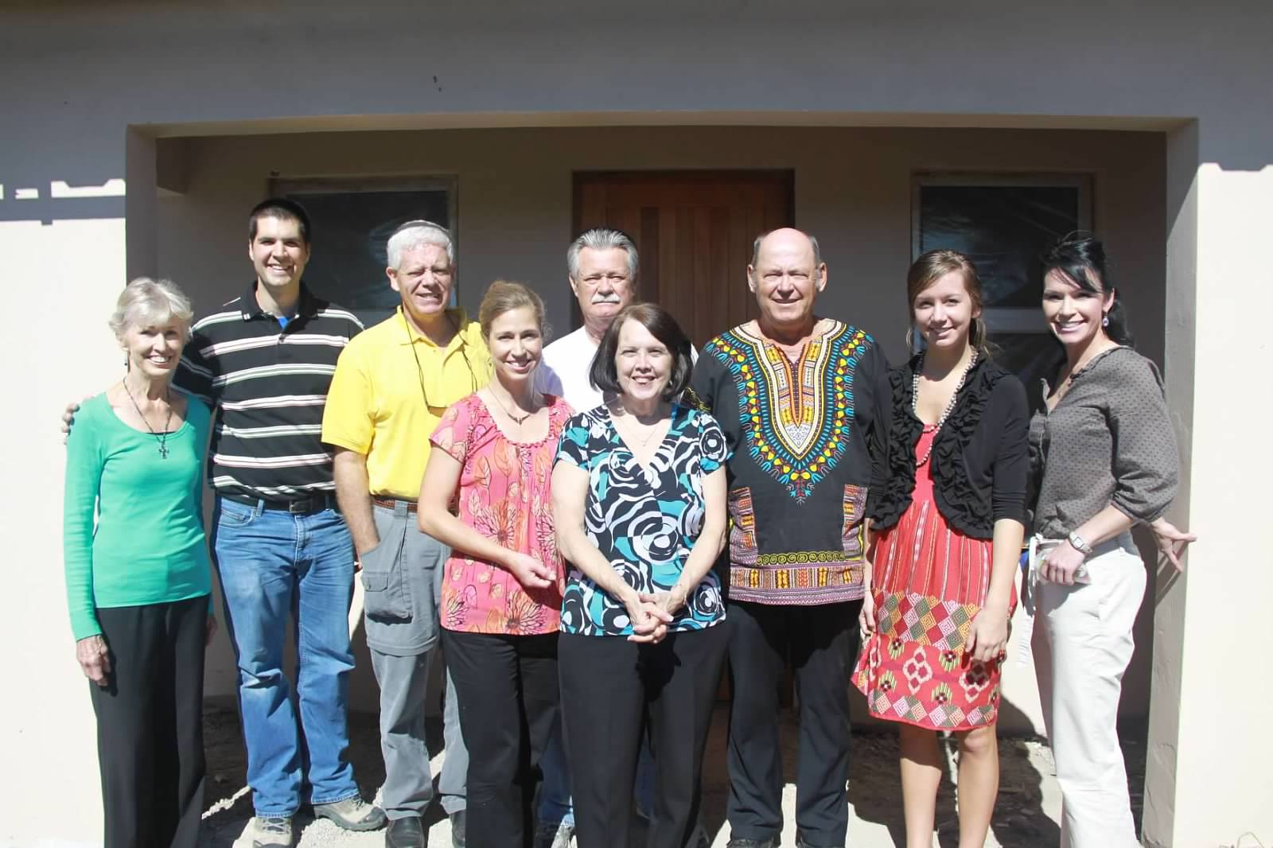
South Africa 2012
You will be my witnesses in Jerusalem, and in all Judea and Samaria, and to the ends of the earth.
Acts 1:8

Slide 2
Amalinda Forest
In 2011 a team of 11 came from First Baptist Spartanburg and helped construct 2 group homes in Amalinda Forest, a Xhosa township in East London, South Africa

Slide 3
We were overwhelmed by the extreme poverty that we encountered in the Xhosa townships

Slide 4
There was miles of fabricated shacks with none of the necessities that we take for granted like electricity or water in the “Squatter Villages.

Slide 5
We helped to build the group orphan homes and we painted the church in Amalinda Forest that serves the Xhosa people

Slide 6
Amalinda Forest children came for Vacation Bible School and we told them of the love of Jesus. Many of the children who came gave their hearts and lives to Him

Slide 7
We visited a site in Scenery Park, another Xhosa Township that would be our next construction site for a group orphan home in the spring of 2012

Slide 8
The first team consisting of Ben, Donnie, Kathy, and Jim left on March 24th, 2012

Slide 9
Scenery Park
Our first glimpse of the work to be done at the group home

Slide 10
Ceilings go up

Slide 11
2nd Team arrives from FBS on March 29th: Lee, Julie, Wendy, and Brianna

Slide 12
The teams become one

Slide 13
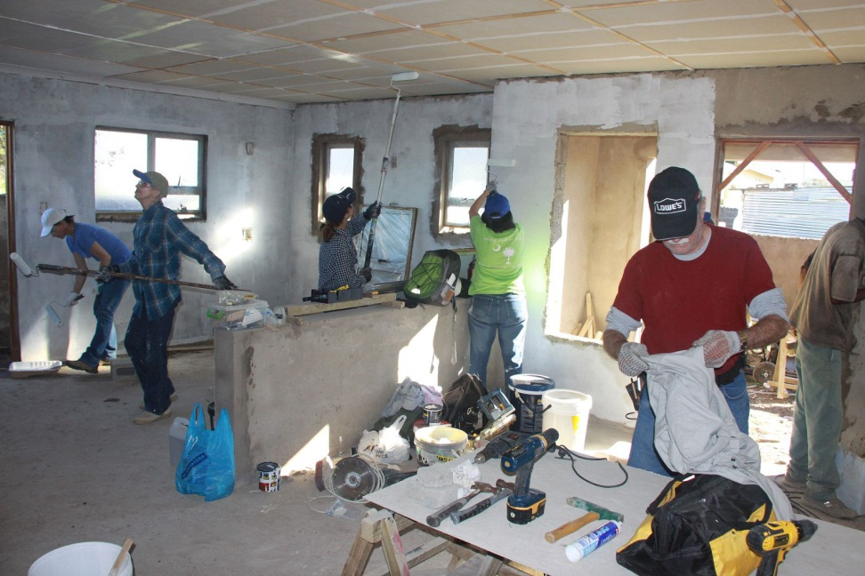
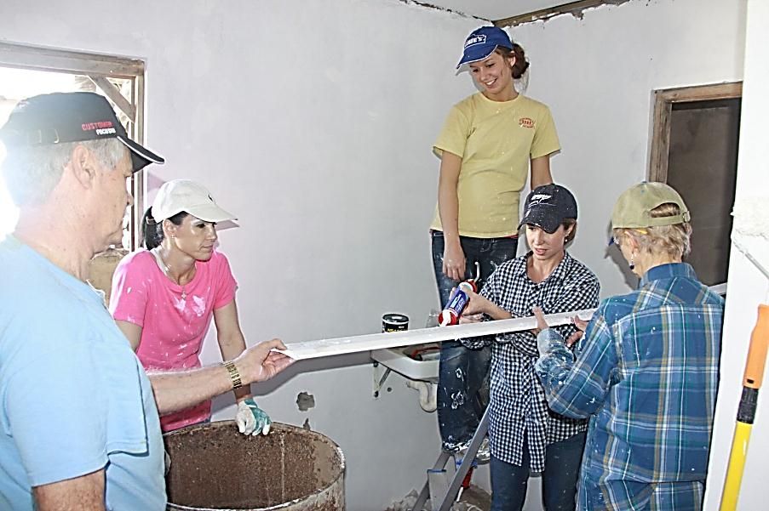
Work Inside
Work inside

Slide 14
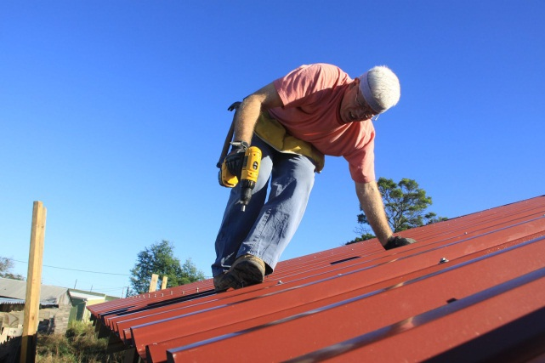
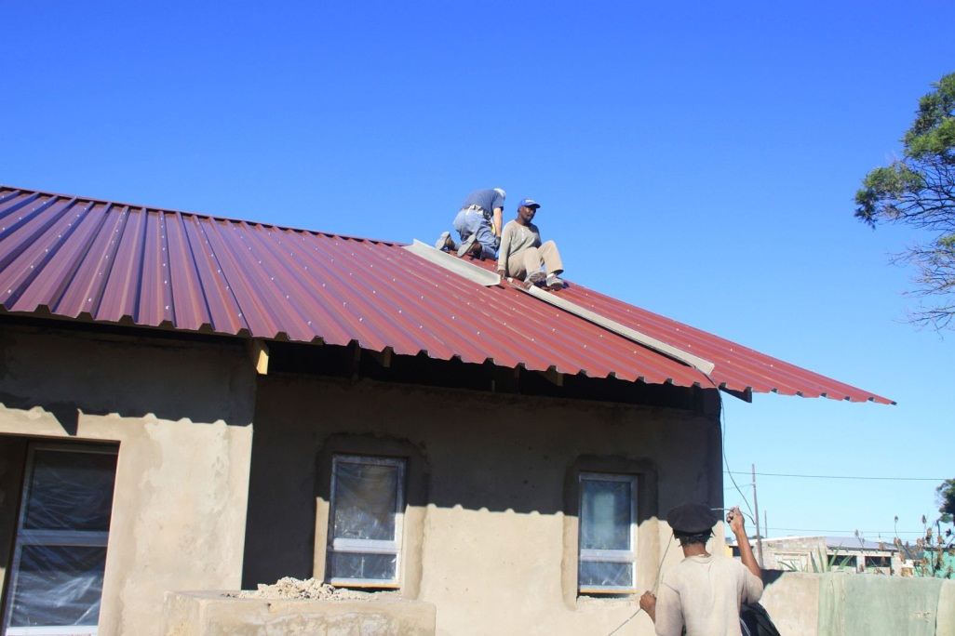
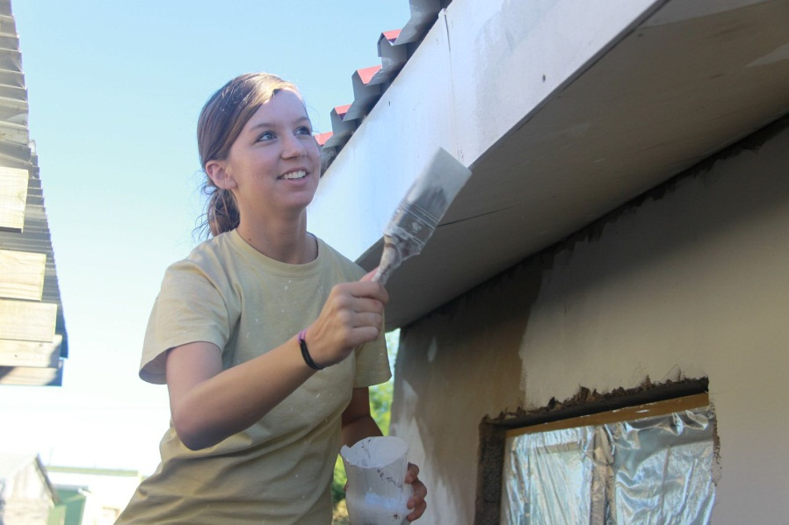
Work Outside

Slide 15
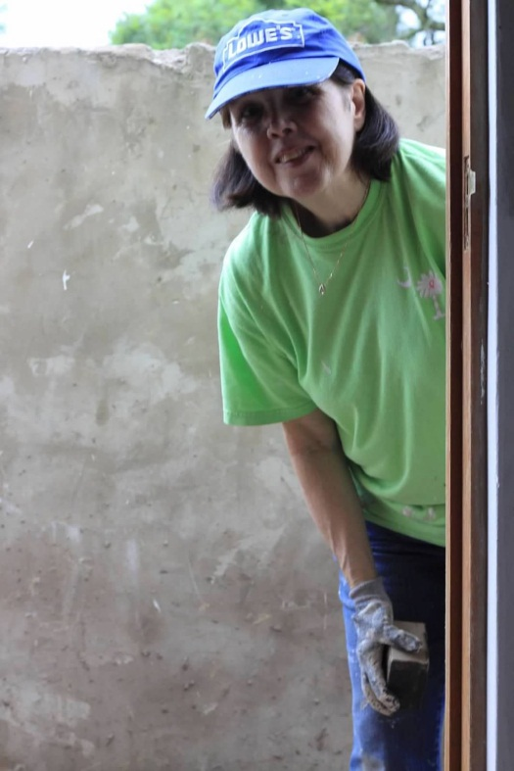
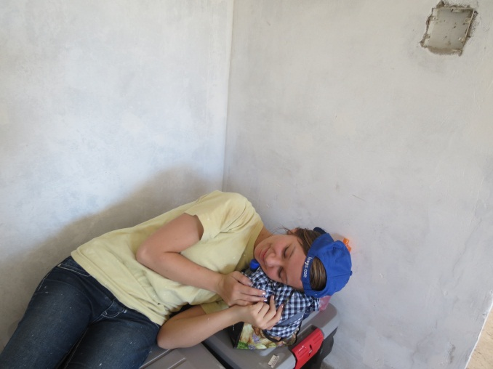
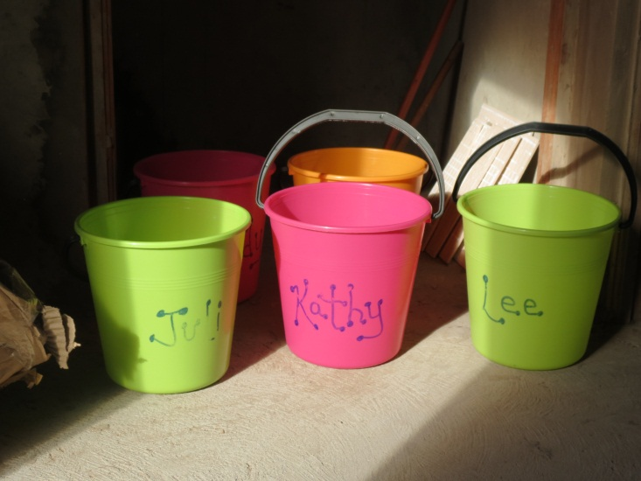
Working?

Slide 16
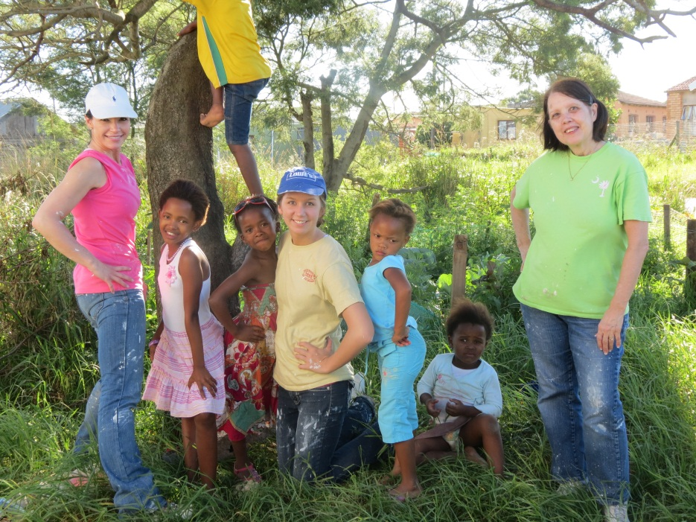
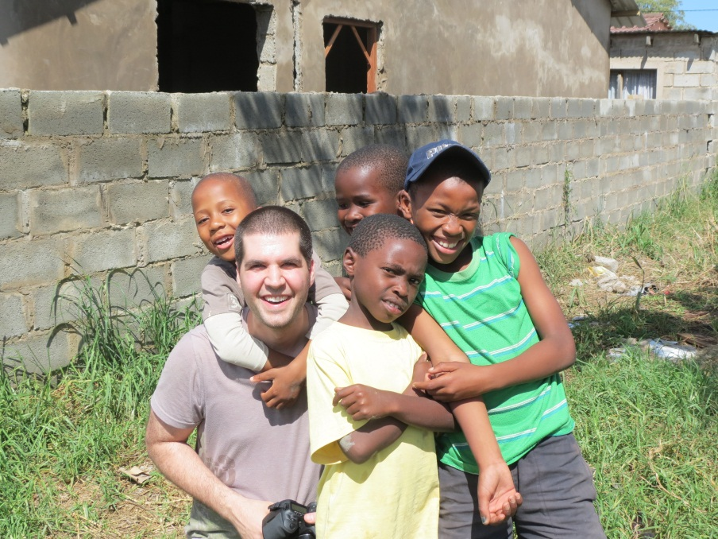
Neighbor children gathered every day to watch us work

Slide 17
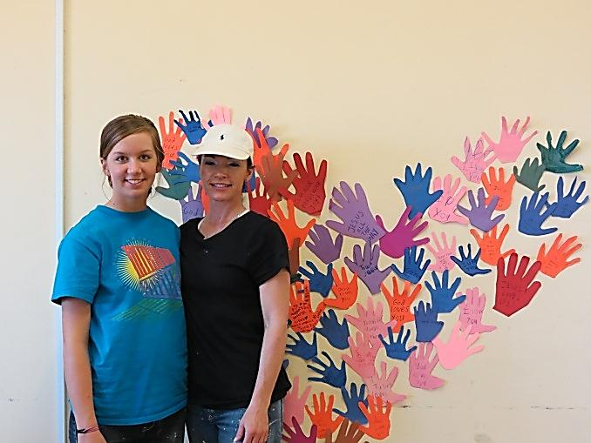
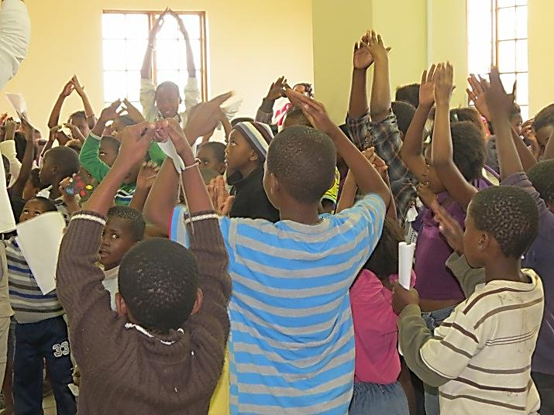
Vacation Bible School at Scenery Park

Slide 18
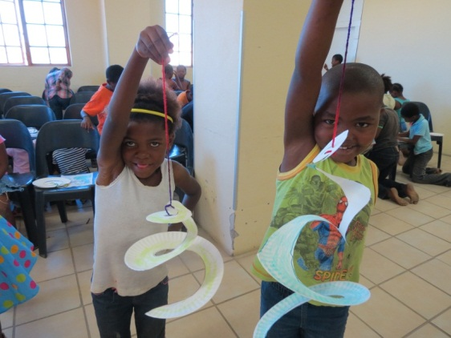
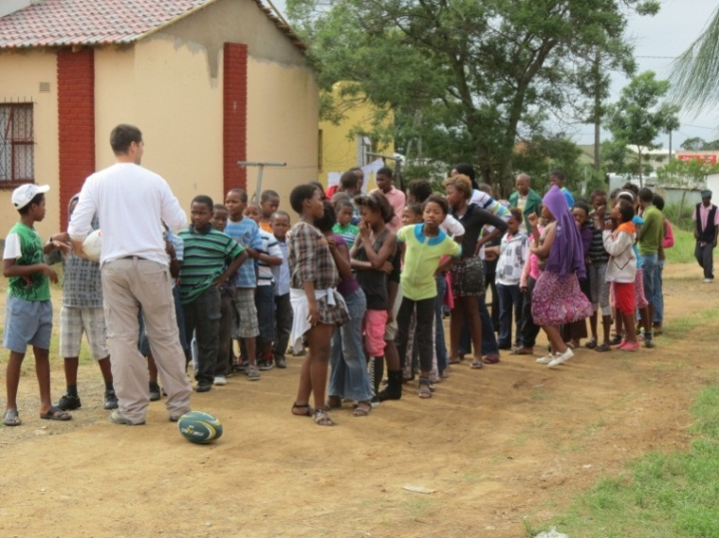
VBS Crafts
Outdoor Games

Slide 19
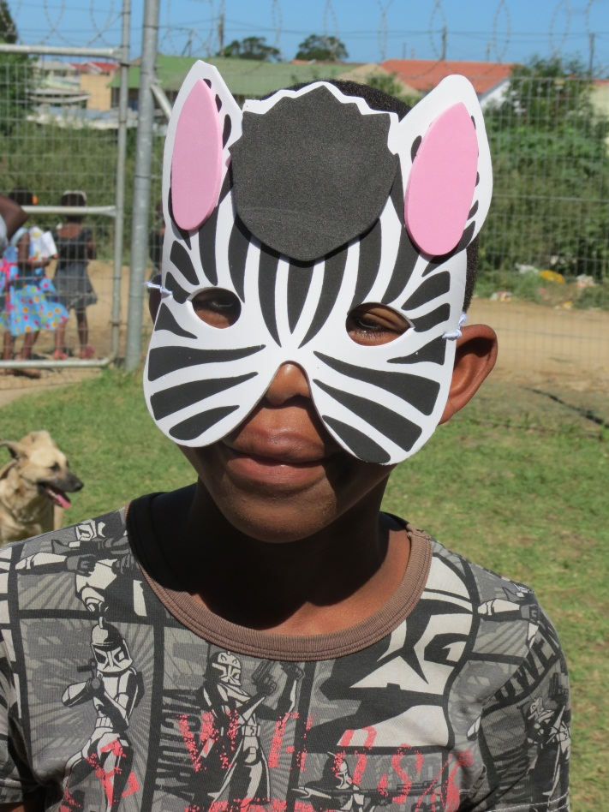
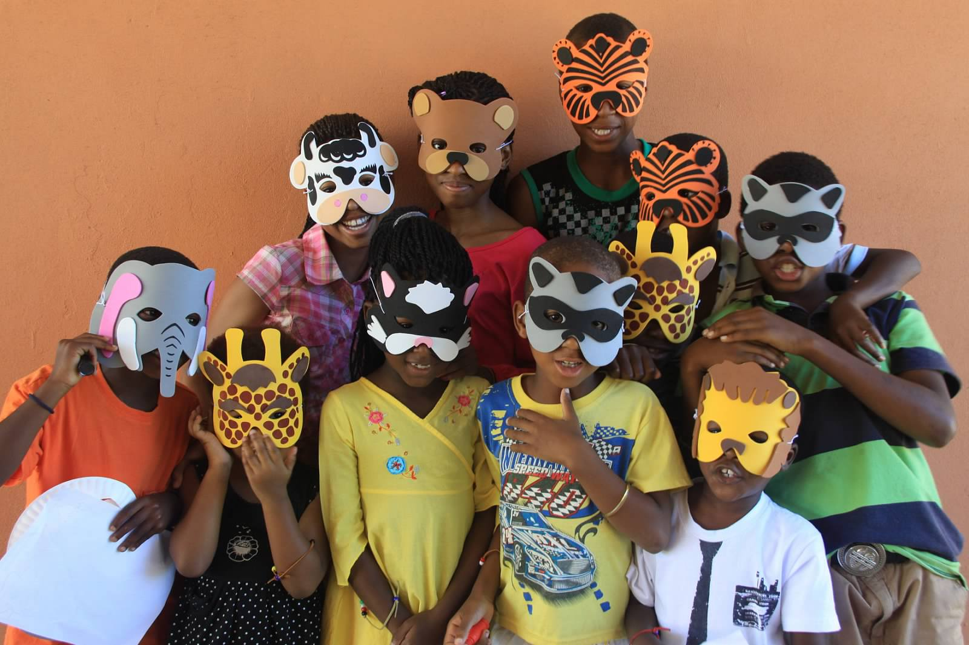
VBS

Slide 20
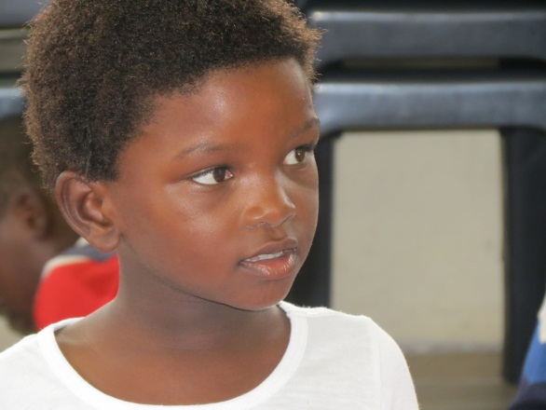
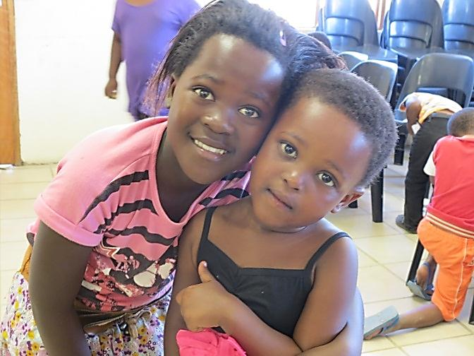
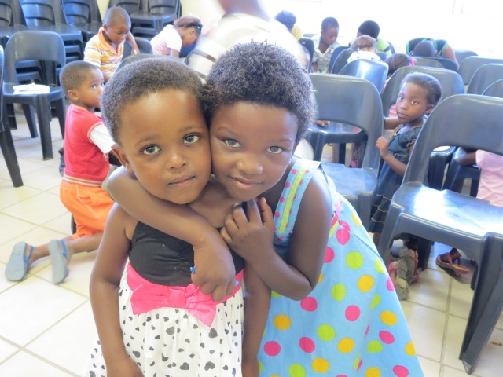
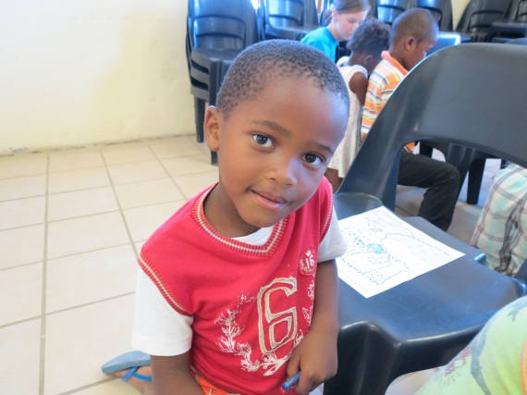
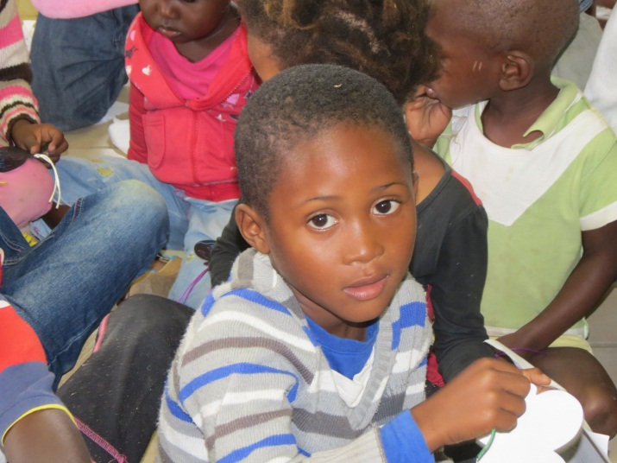
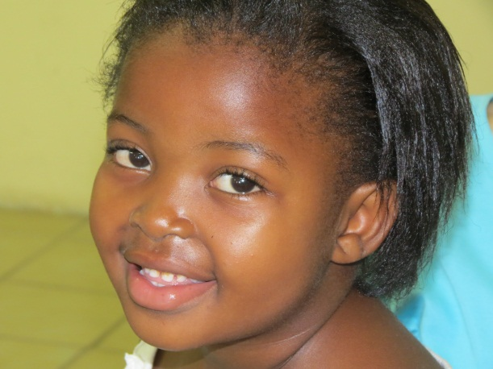
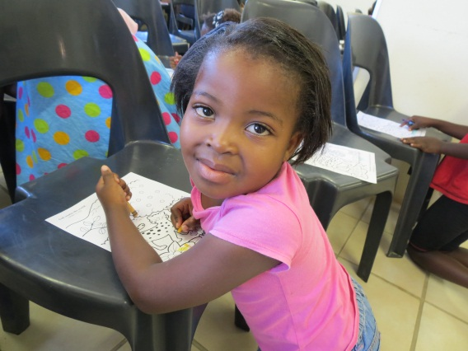
VBS Friends

Slide 21
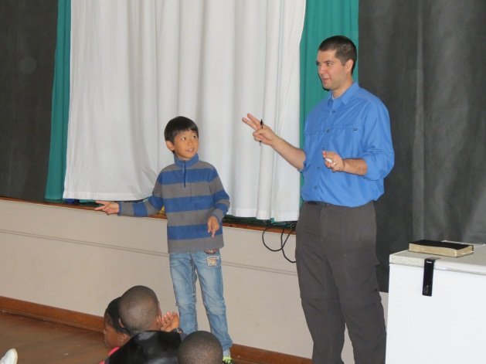
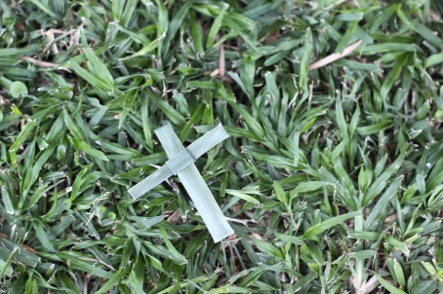
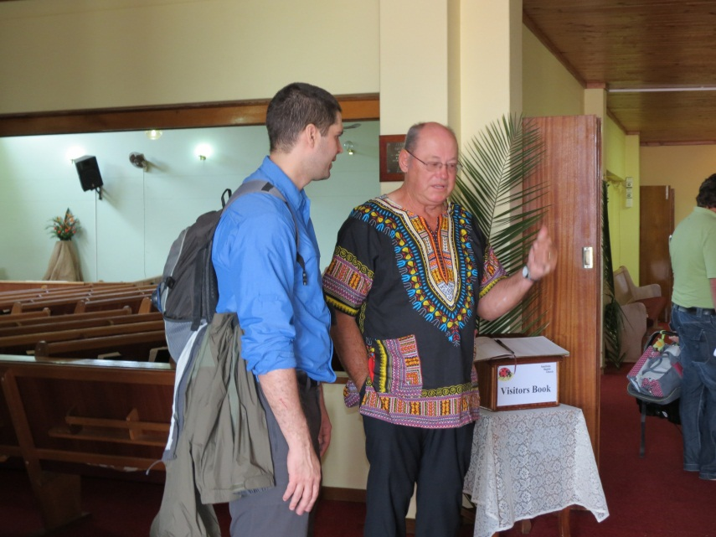
Palm Sunday worship at Amalinda Baptist
Children’s Sunday School

Slide 22
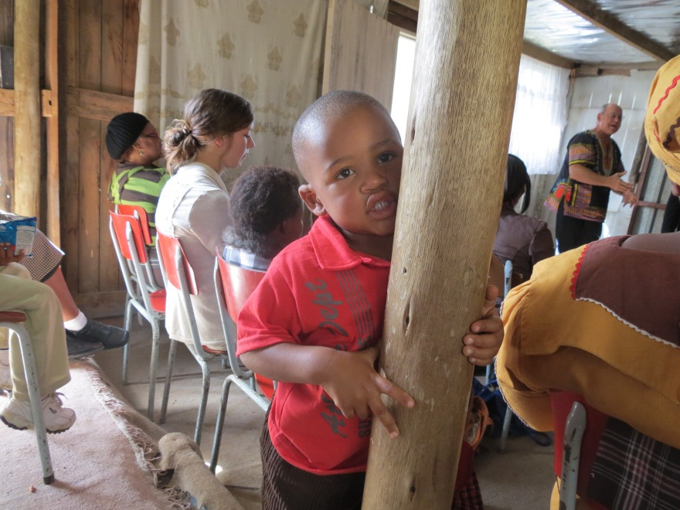
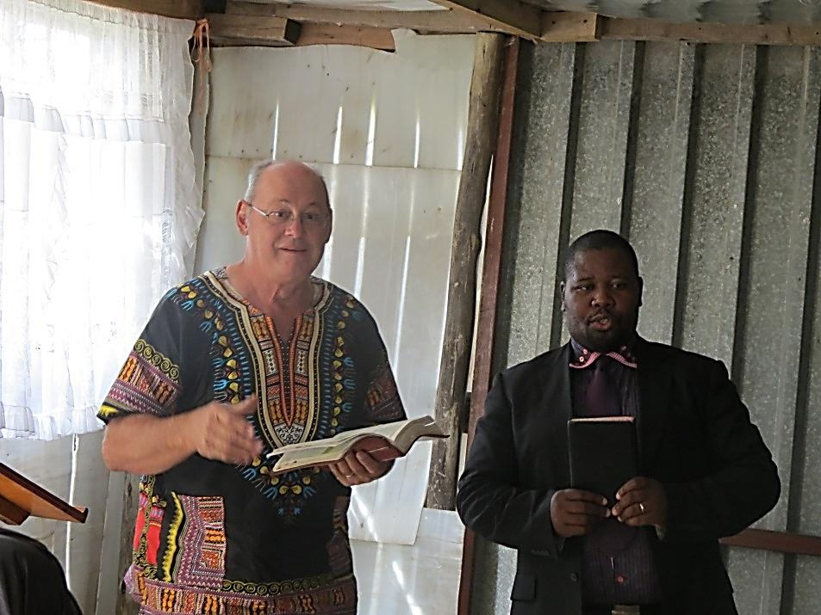
We worshipped together at Khayelitsha with Pastor Nicholas

Slide 23
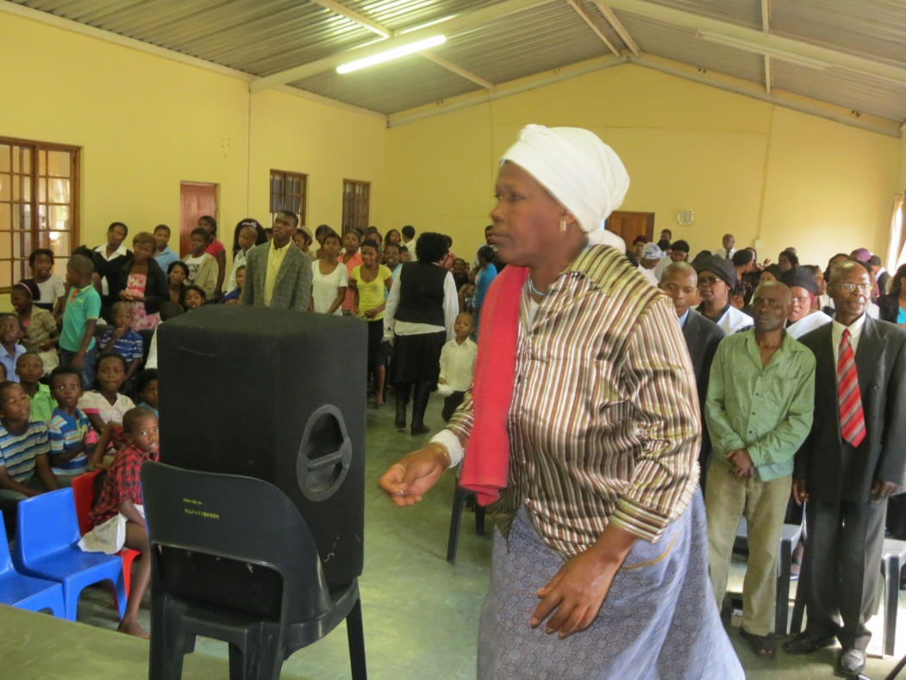
Good Friday at Scenery Park

Slide 24
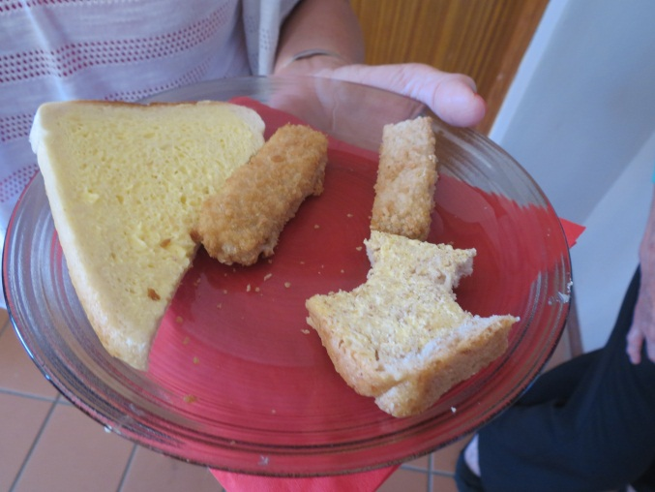
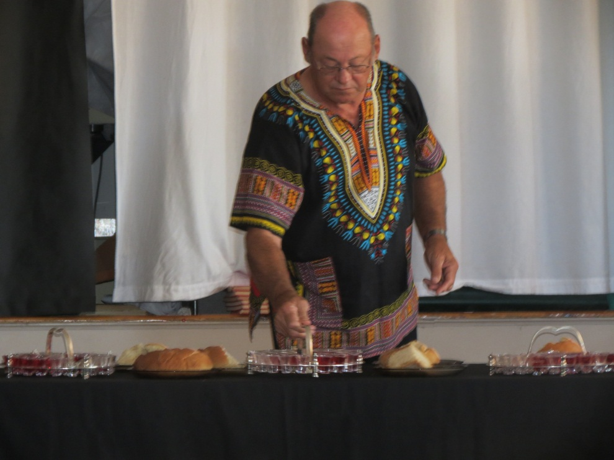
Easter in SA
Fish Breakfast
Communion

Slide 25
We stood in awe of God’s creation

Slide 26
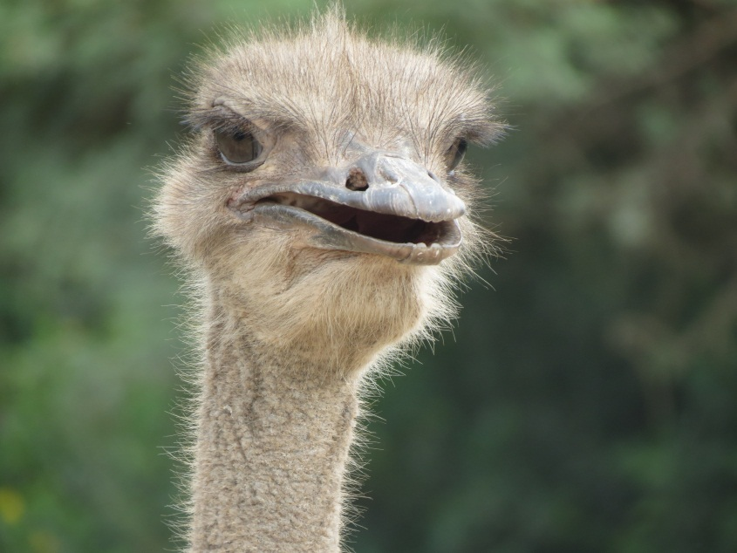
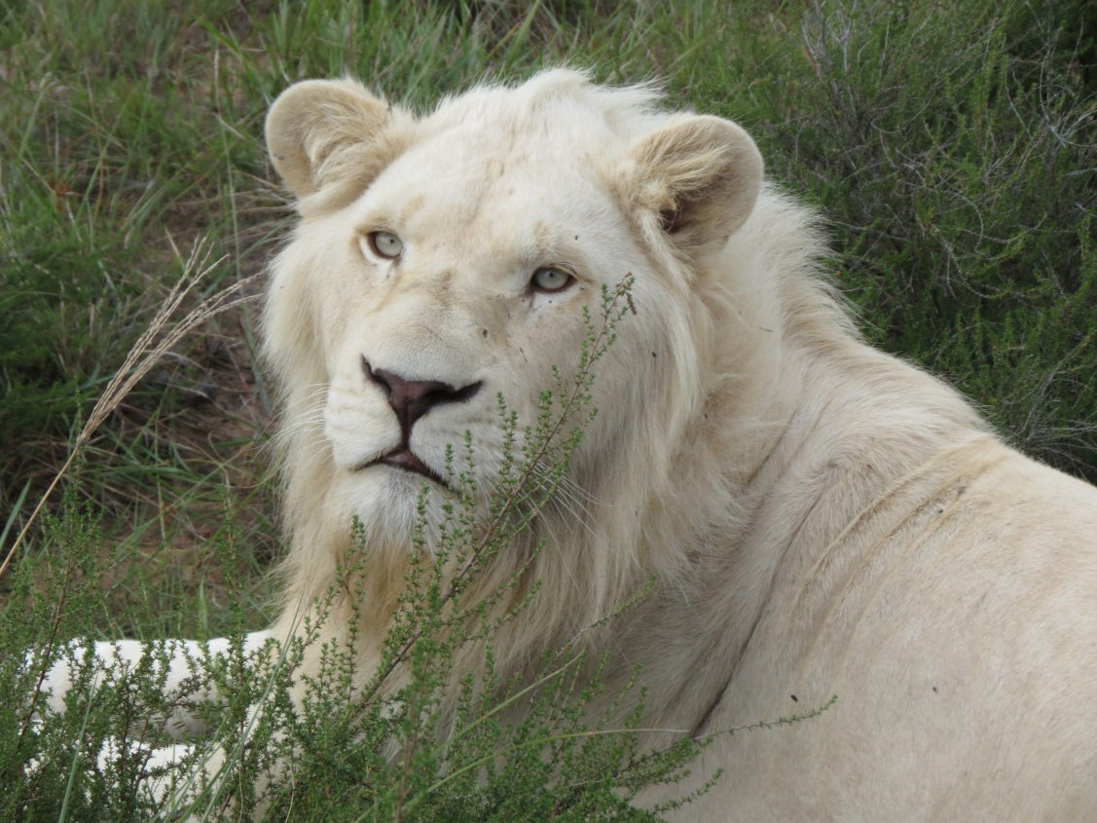
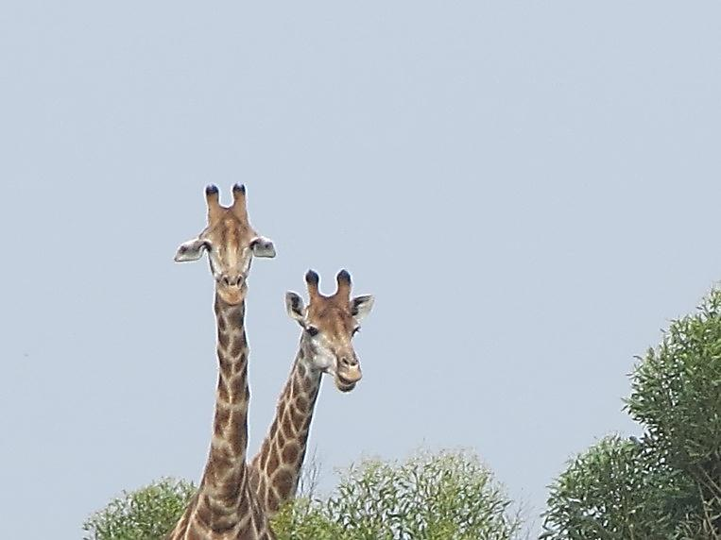
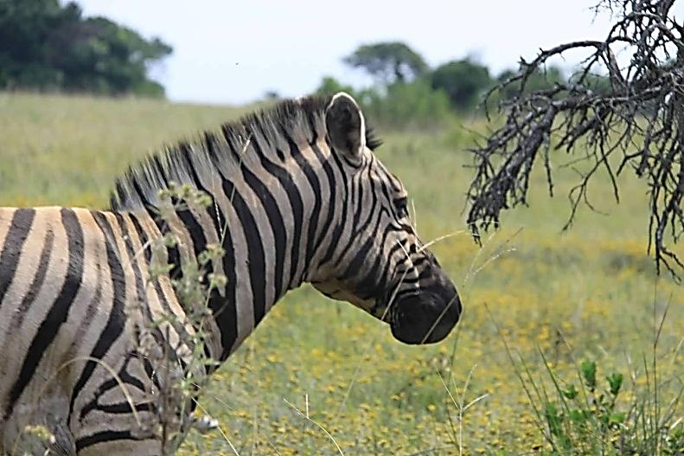
God’s creatures great and small

Slide 27
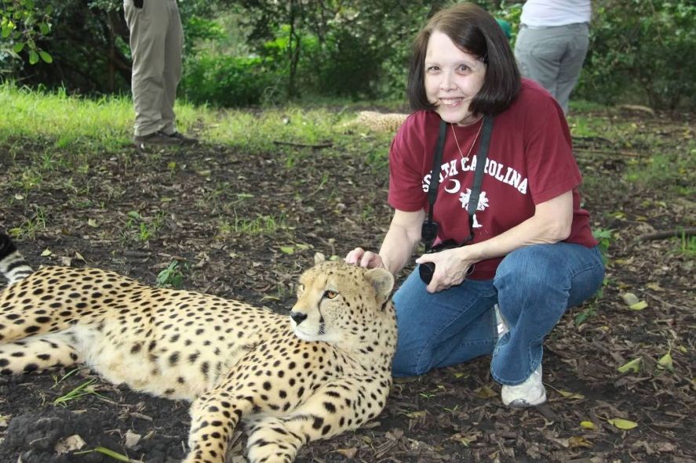
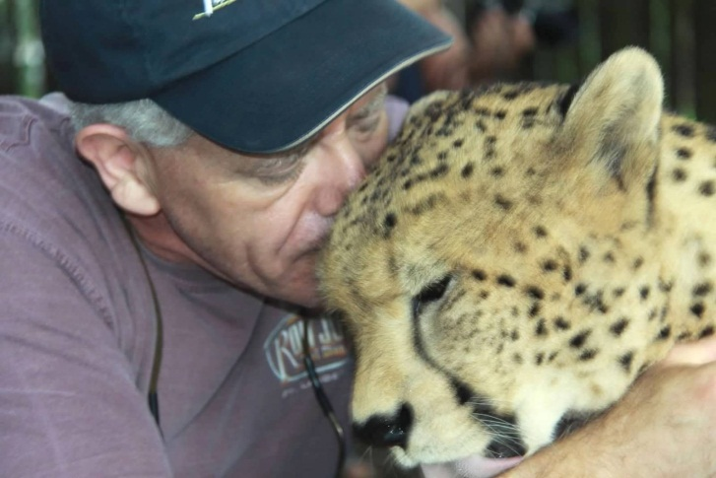
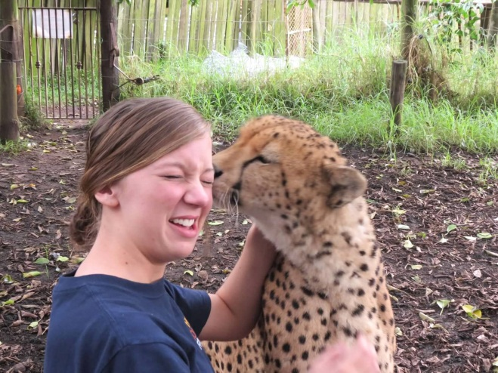
Loving on God’s creatures

Slide 28
Amalinda Forest group home children

Slide 29
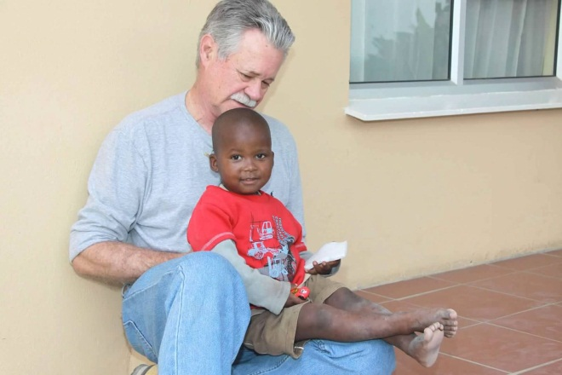
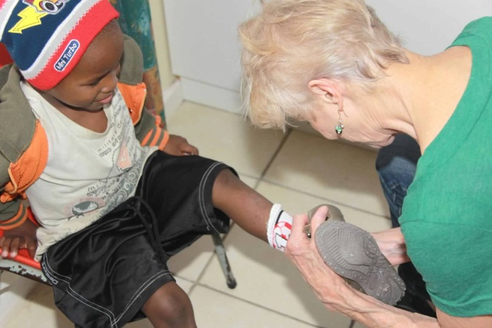
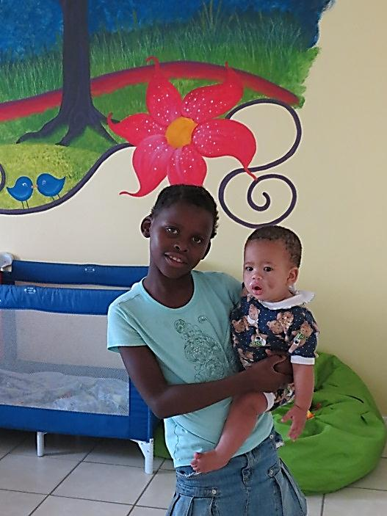
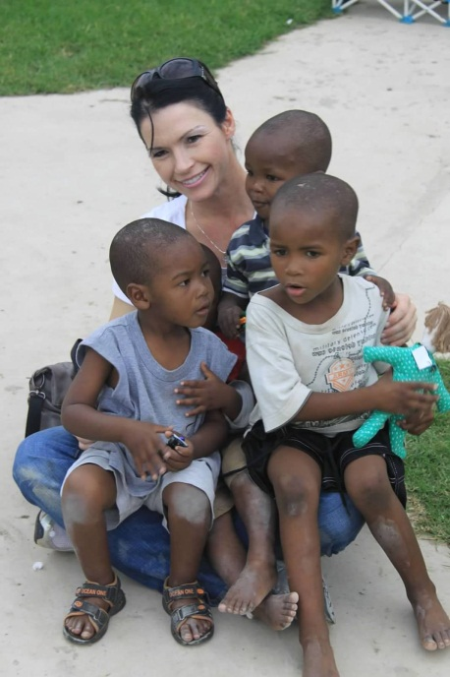
The children at group home at Amalinda Forest

Slide 30
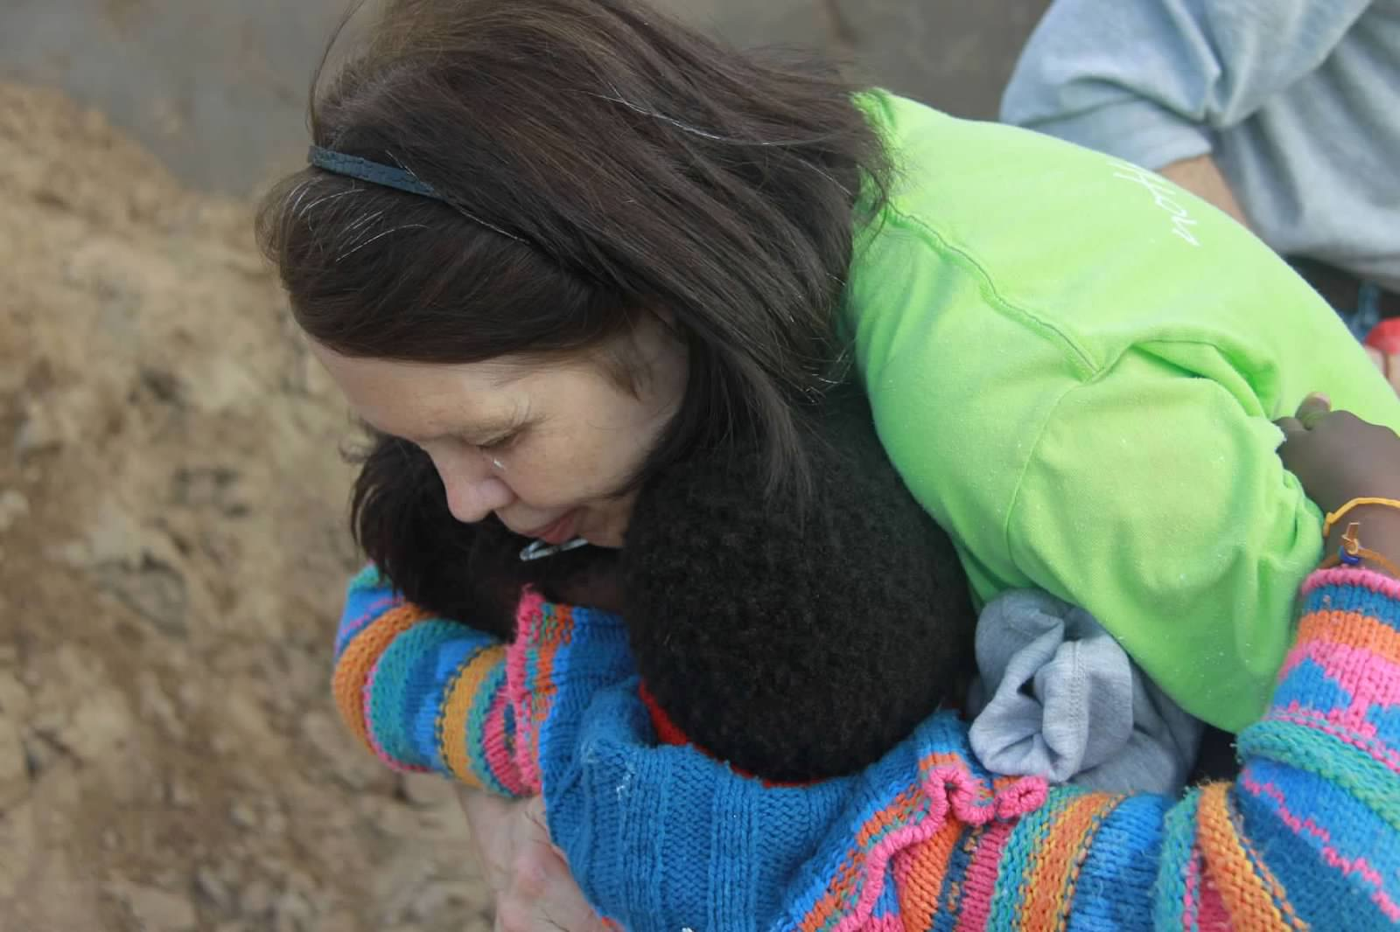
Goodbye to friends at Scenery Park

Slide 31
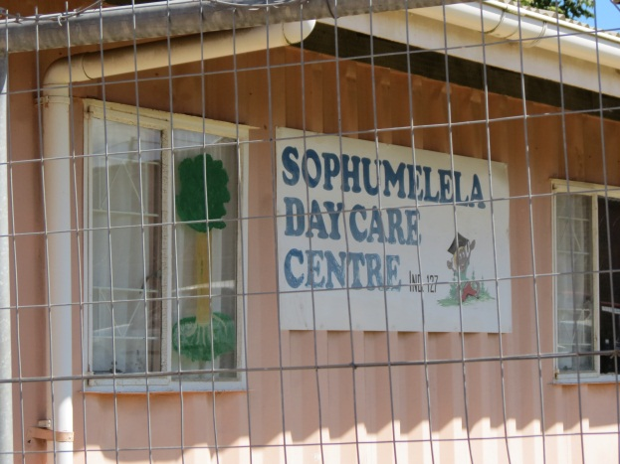
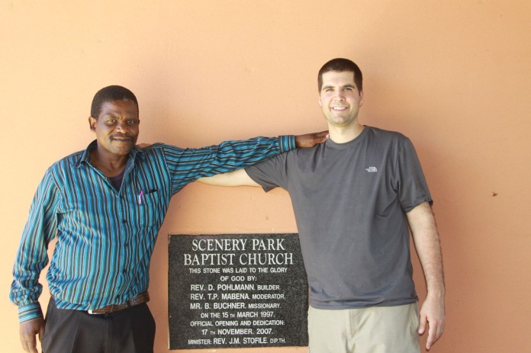
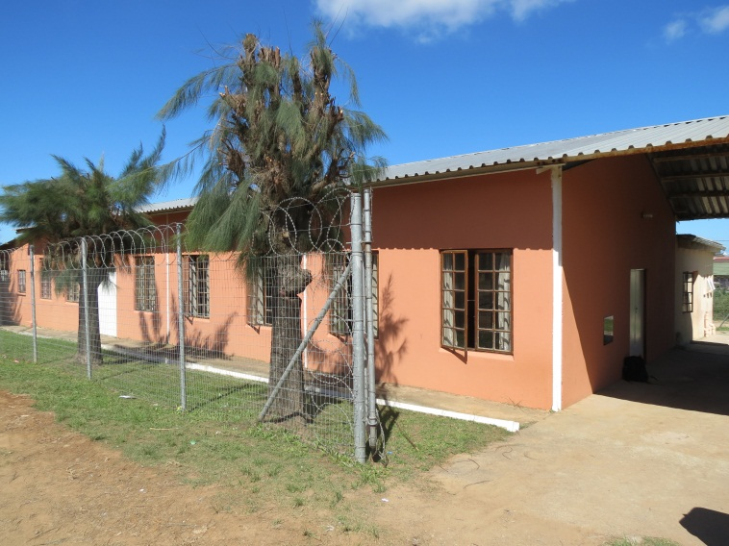
Scenery Park – a circle started
The home is not finished
The circle needs to be completed

Slide 32
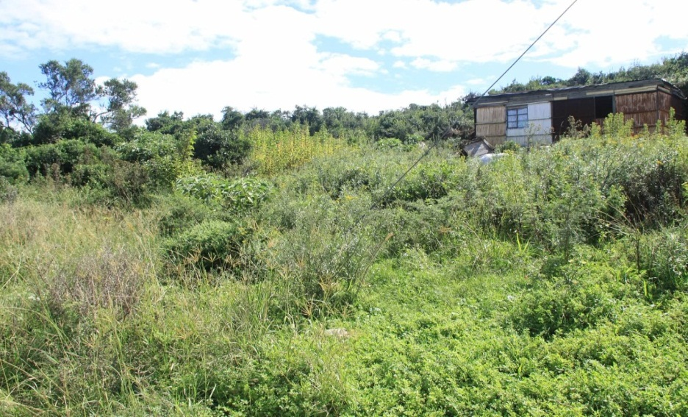
Khayelitsha – a new Circle?
A new church is desperately needed
A day care and group orphan homes are needed
Land has been identified as a possible building site for the future

Slide 33
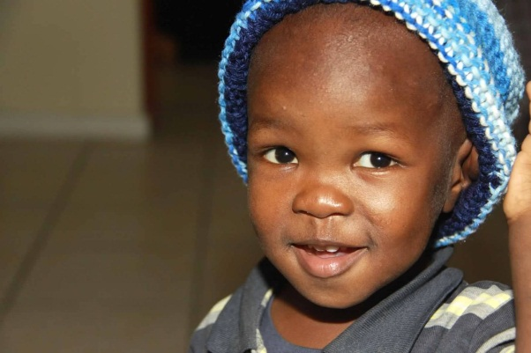
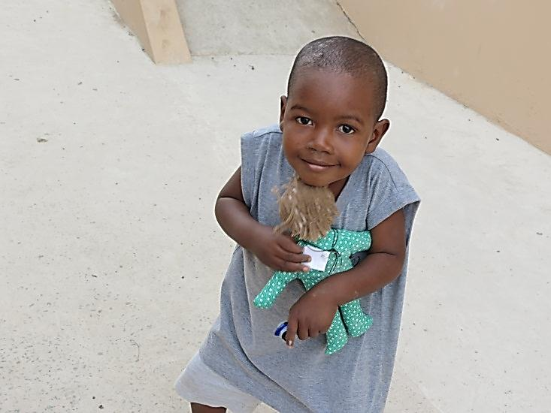
How we can continue helping
Clothing, blankets, warm hats, and comfort items for the orphans
Bibles for the hospital ministry

Slide 34
Prayer & Support
Pray for the Xhosa People and our partnership with S.A.
Pray for Amalinda Baptist Church, and the leaders of this effort in S.A.
Pray for more teams to help continue the work in S.A.
Pray for the team leaving on August 2nd to complete the house in Scenery Park
Support those who can go on mission

Slide 35
Galatians 6:9
“Let us not become weary in doing good, for at the proper time we will reap a harvest if we do not give up.”

